Slide 1
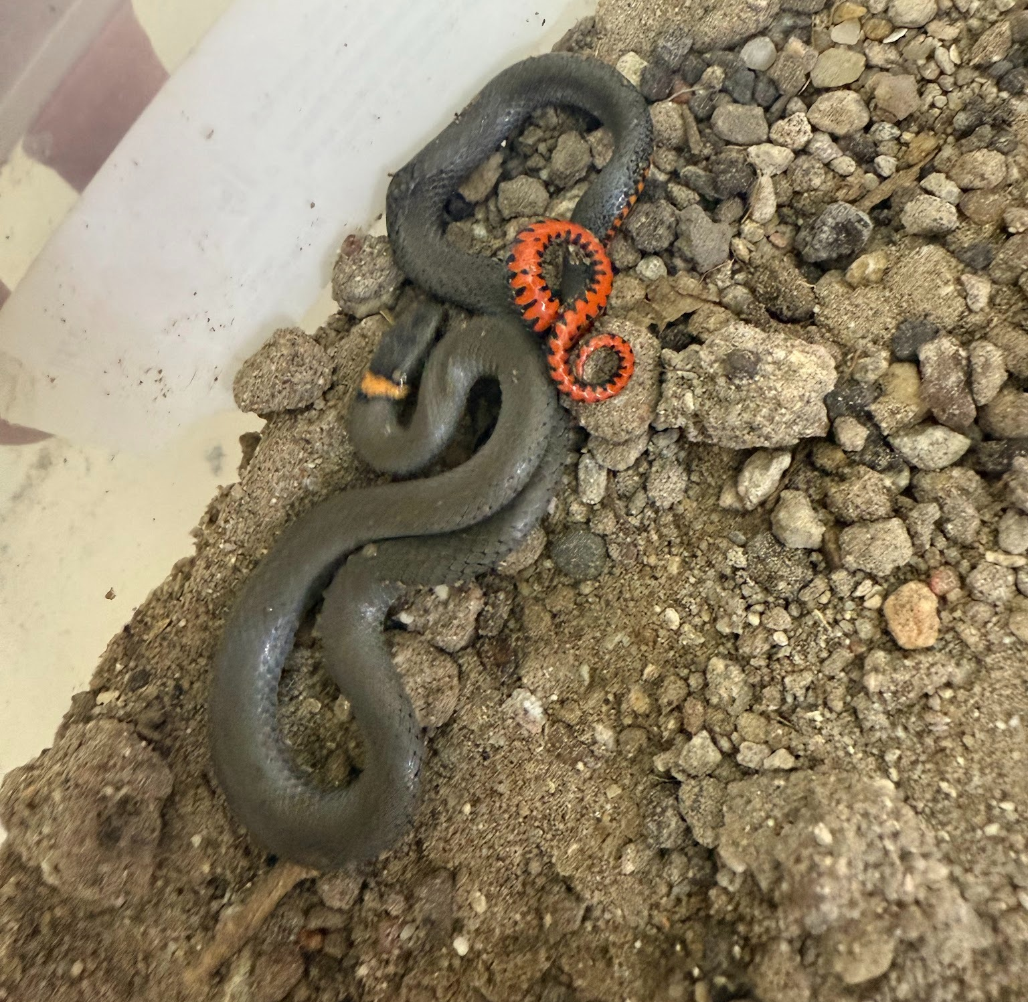
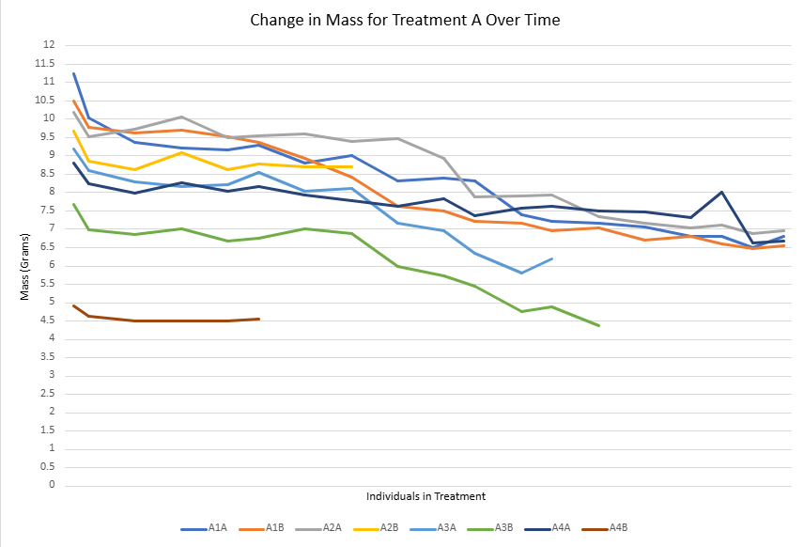
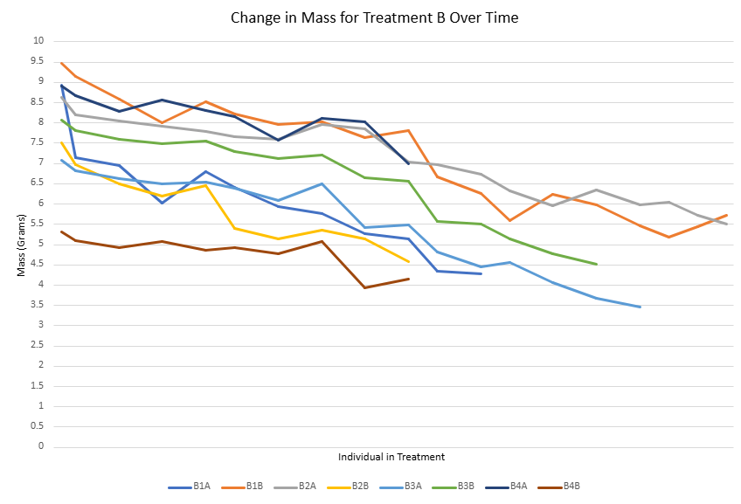
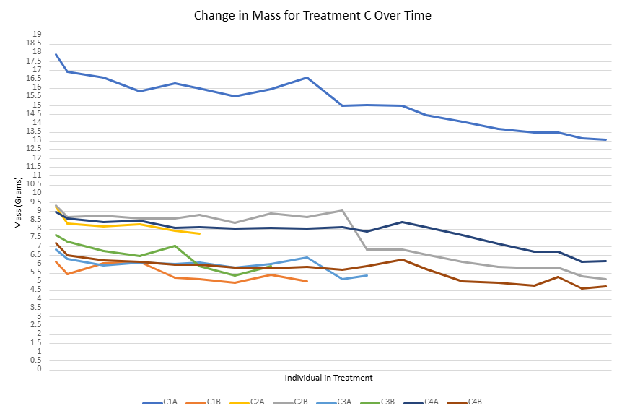
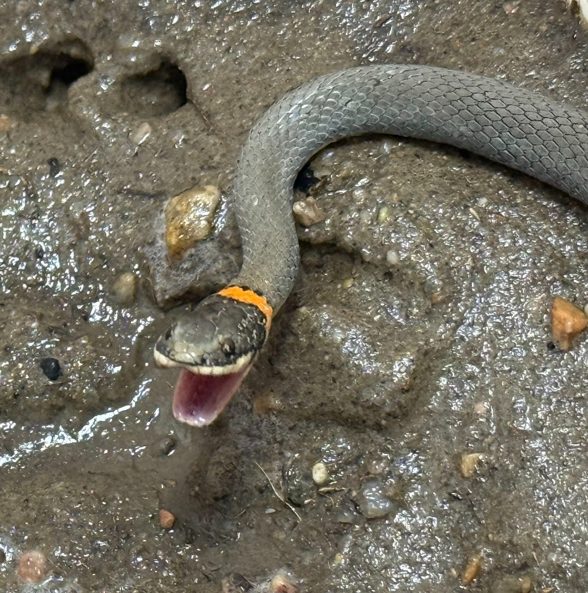
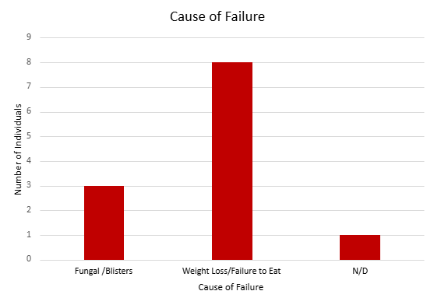
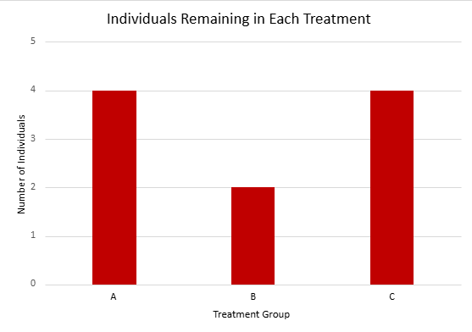
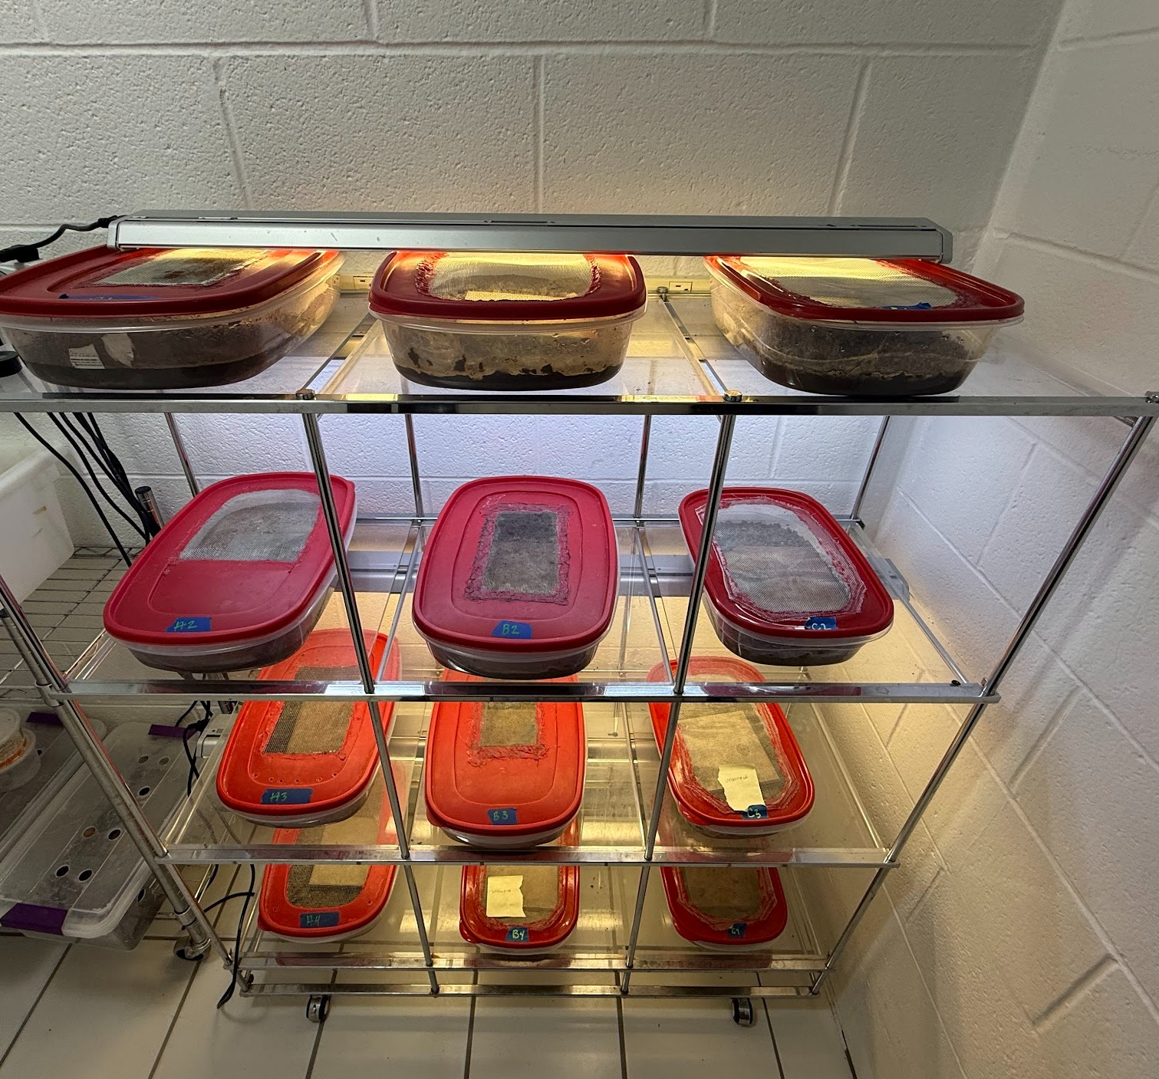
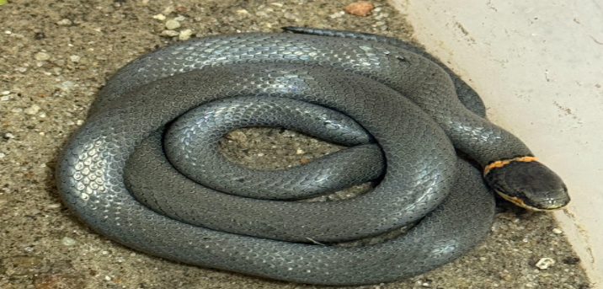
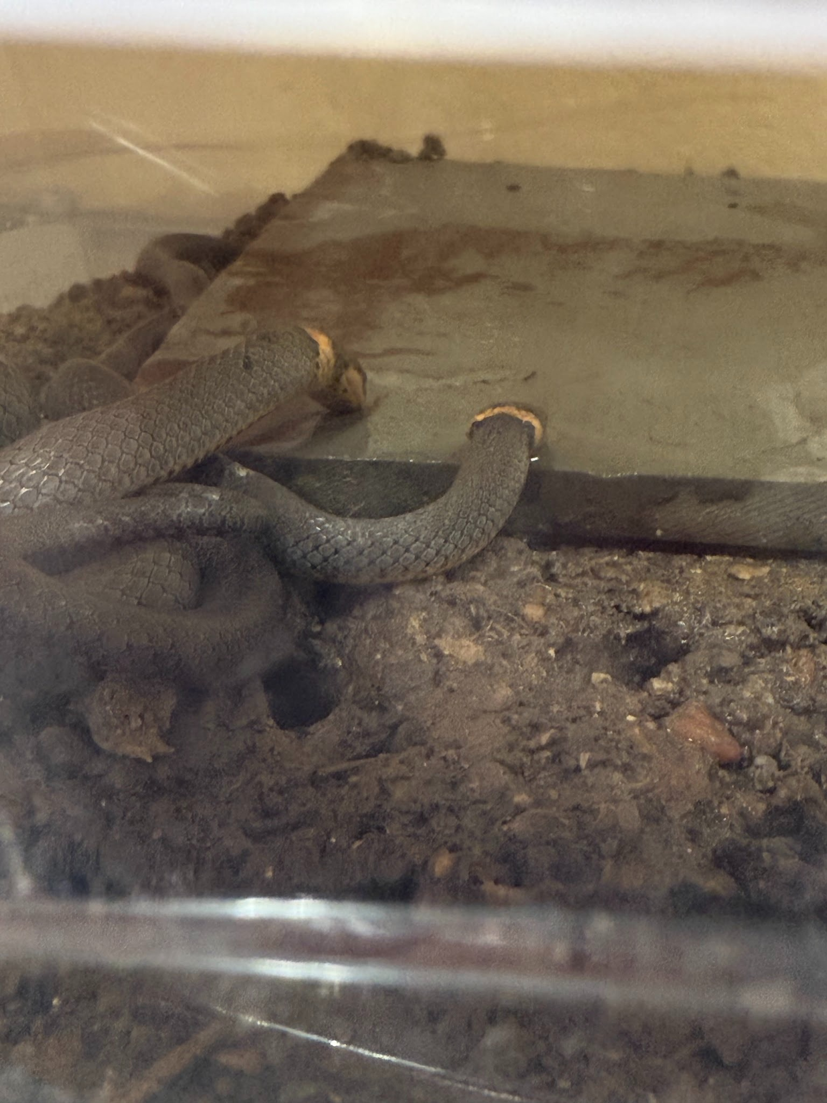
Investigating the Effect of Substrate Types on the Survival of Prairie Ringneck Snakes (Diadophis punctatus arnyi)
Emily Deming
Advisor: Dennis Ferraro
School of Natural Resources University of Nebraska-Lincoln
Introduction
Prairie ringneck snakes (Diadophis punctatus spp) are an intercontinental fossorial species of snake and can live in a large variety of habitats. Their genetic spread can be limited due to the topography of their landscape and their small size and individual range. The purpose of this research is to determine whether soil type significantly affects the viability, survival, and ultimately range of prairie ringnecks (Diadophis punctatus arnyi) in Nebraska. This study aims to provide valuable insights into the species' reproductive ecology and aid in determining the reasons behind the limited range to soil type in Nebraska. This study additionally aims to fill in gaps as to potential barriers in the range of prairie ringnecks as well as including insight to the impact climate change may have on their range.
Results
Figure 1: Ringneck exhibiting defense posture
There was some variation in masses. I calculated a p value= .65 using a chi-squared, which suggests that soil type has no statistical significance on survival. This is despite there is variation in individuals remaining among the trials, where Treatment B had the least remaining.
The greatest mass losses were B (-3.87± 1.92g), C (-2.76±1.63g), and then A (-2.31±1.48g). There was additionally a net loss of weight across all the trials.
The most common cause of failure was due to weight loss and subsequent gall bladder bursts. There other main cause was due to fungal blisters related to over-hydrated conditions.
Methods
24 Adult Prairie Ringnecks were collected from various locations in Nebraska and randomly placed into 1 of three treatments. 2 adults were placed in each treatment tub that consisted of 2 inches of substrate, 1 inert tile as a hide, and prey items (worms and isopods). There is a dry and wet side of the tub, and it is watered and misted every other day to simulate dew. All of the soils were steam sanitized prior to the start of the experiment. The treatments include A: Sand from Keith County Nebraska B:Soil from Cherry County, Nebraska C: Clay Soil from Douglas County, Nebraska Every other day the tubs are watered, measurements on moisture, pH, temperature, and food availability. Once weekly, each individual is weighed to monitor health. Failure to survive was determined by mortality or weight loss greater than 50% initial body weight.
Figure 2: Ringneck adjusting mouth
Discussion
Although there was not a significant variation in survival between treatments based solely on substrate type and composition, the loss of mass and failure to survive may have closer ties to available water and physiological stressors. Stress from handling and disturbance may have played a large role in lack of feeding even though prey items were available. Failure to eat and subsequent gall bladder bursts were the main cause of failure in this experiment. There were multiple prey items of different sizes and species available to the snakes at all times. Constant disturbance and handling stress I think played a key role in the lack of feeding. Fungal and moisture blisters also caused failure in multiple individuals. These appear when moisture is too high and constant on the skin, which can provide insight to the ideal conditions of Ringnecks. It was also noted repeatedly throughout the study that the Ringnecks would emerge after misting took place. The misting was intended to emulate morning dew, and the snakes would drink water directly from the inert tile or side of enclosure instead of drink water off the soil under their hides. This may provide insight to behaviors the snakes display to obtain water. It has been thought that they drink water out of pockets in the ground, or they prefer areas of more moisture. I believe that future studies should be done to determine this further.
Figure 3: Investigation setup
Contact Information:
Email: edeming598@gmail.com
Phone: 402-415-9784
Acknowledgements
UNL UCARE Program
UNL Herpetology Labs
Dennis Ferraro
Kenneth Pyle
John Lokke
Snakes drinking simulated “dew”

