Slide 1

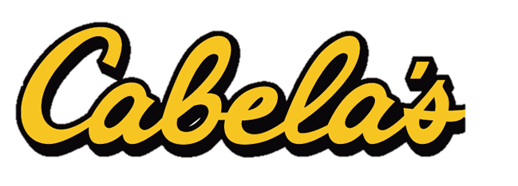



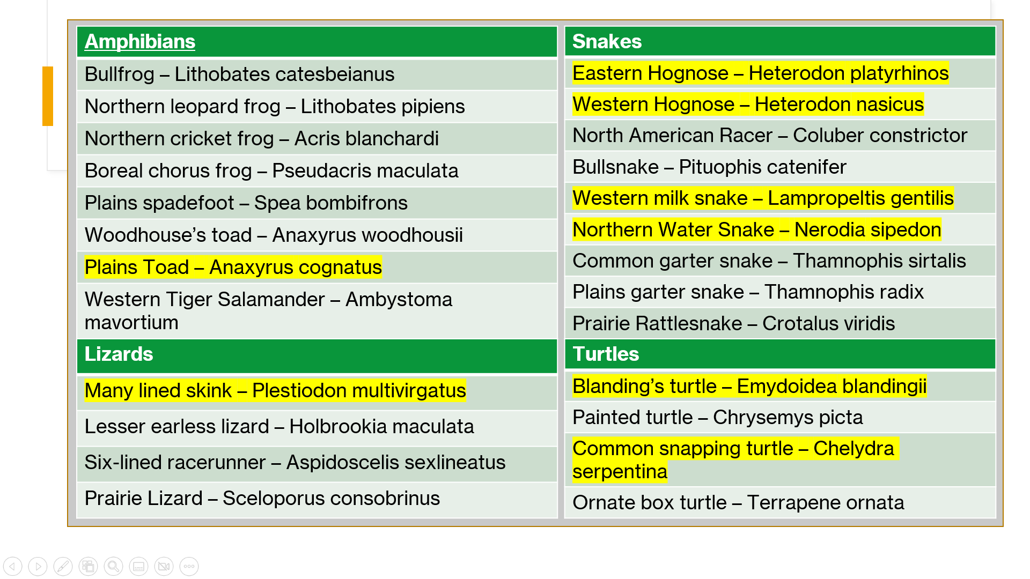
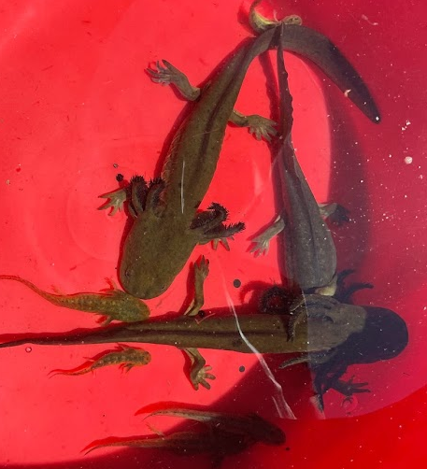
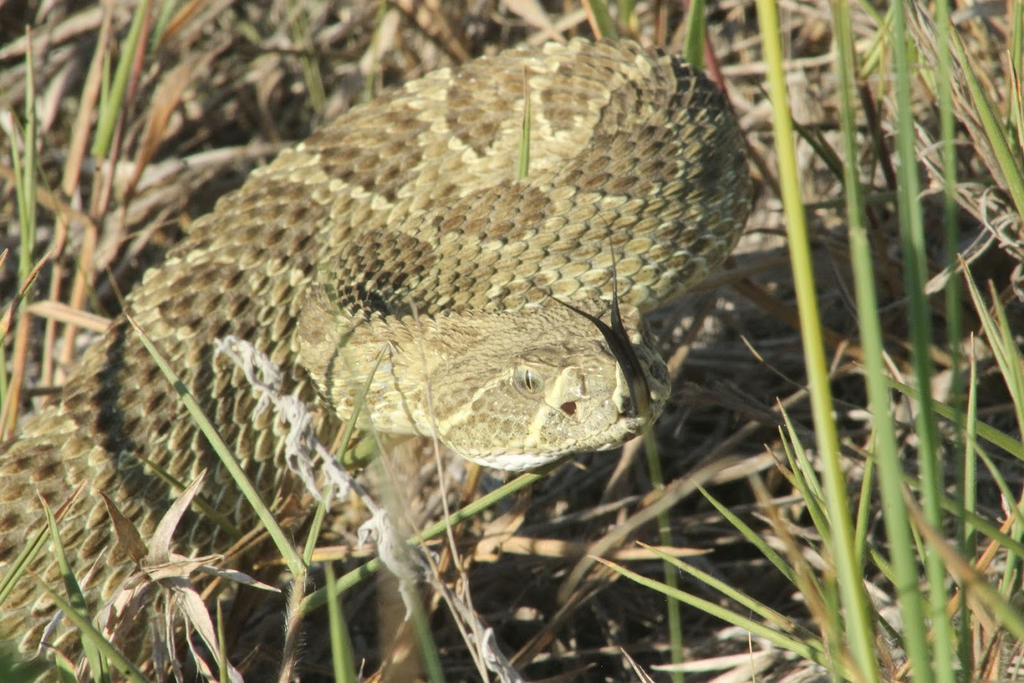
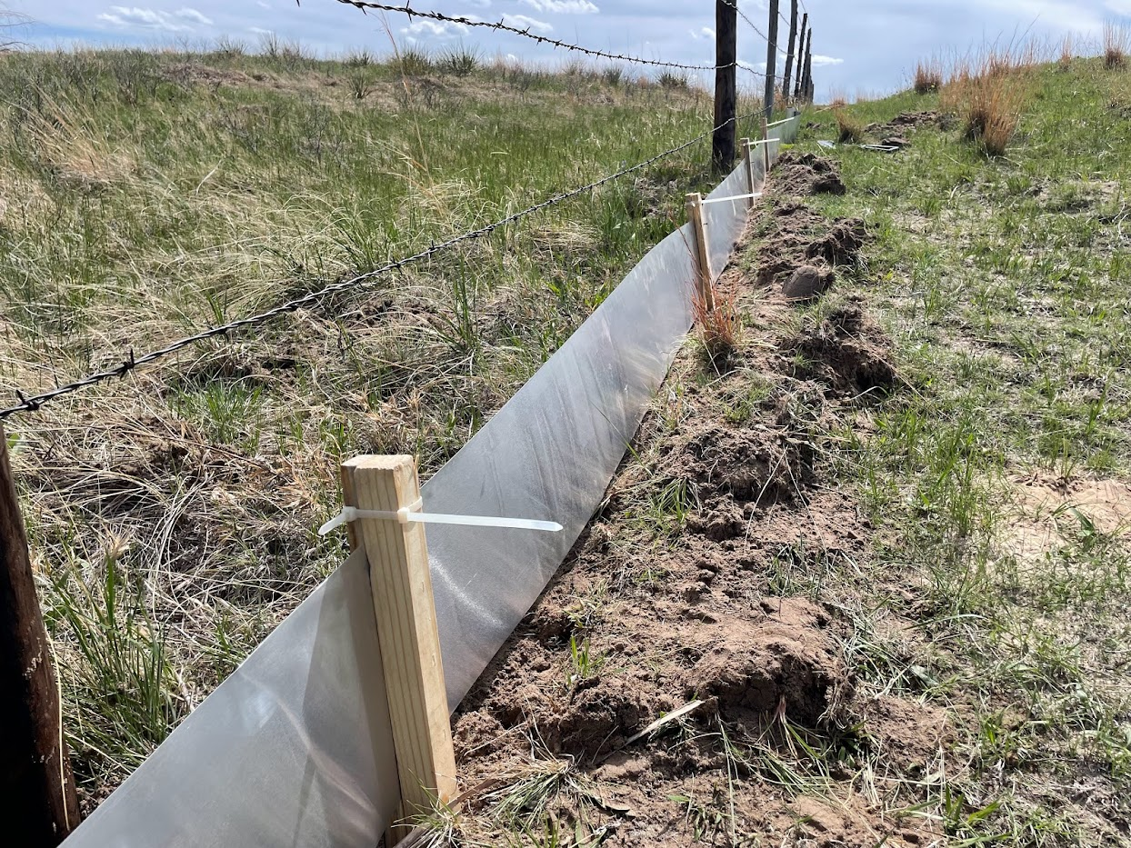
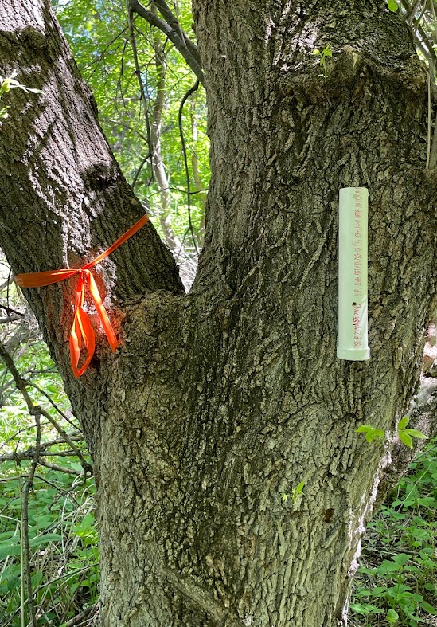

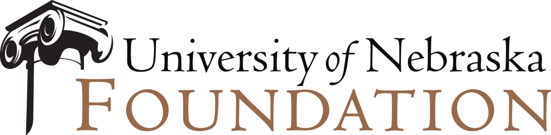
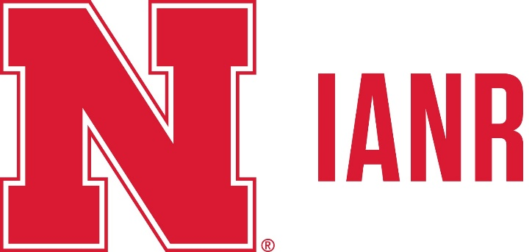
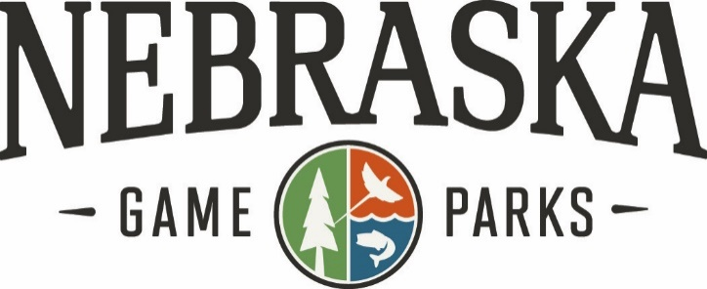
2022 Cabela’s Apprenticeship
Presence/Absence Survey of Herpetofauna at Niobrara Valley Preserve
Matthew Klein
Advisor: Dennis Ferraro
The Nature Conservancy at Niobrara Valley Preserve is approximately 56,000 acres of sandhill prairie, oak savanna, and coniferous and deciduous forest along the Niobrara River.
The previous herpetofauna specific survey occurred in 1982, as such, there is a need for updated data on species occupancy on the property.
The goal of this study was to complete a comprehensive survey of herpetofauna species on property, identify new species or lack of previously known species on the property.
Data collection June 1st – August 5th
Trapping Methods
  Coverboards
  Drift fences with pitfalls & funnel traps
  Hoop nets
  Transects/visual search
  Tree frog refugia
Coverboard grids/transects and rotating drift fence locations
Individual species data parameters collected after capture
Environmental conditions (e.g., air temperature, humidity, wind speed), GPS, habitat information collected at time of capture
17 total species, 6 anurans, 1 caudata, 2 chelonians, 3 lizards and 5 snakes were identified. In comparison, the 1982 study found 25 total species, 7 anurans, 1 caudata, 4 turtles, 4 lizards, and 9 snake species.
The reduced species diversity and overall low quantities of individuals found is likely a result of drought conditions during the 2022 summer.
Further survey work should be continued on site to expand the current data set and improve our understanding of herpetofauna diversity and occupancy at The Niobrara Preserve.
Results
Table 1. All species found in 1982, and those found in 2022 (not highlighted). Those highlighted were not found in 2022
Table 2. All species found and number of individuals captured or observed
The Cabela’s Apprenticeship program is a collaborative effort among Cabela’s, Nebraska Game and Parks Commission, and University of Nebraska-Lincoln to provide tangible, experiential opportunities for undergraduate and graduate students committed to conserving fish, wildlife, and wild places.
The University of Nebraska–Lincoln is an equal opportunity educator and employer.

