Slide 1
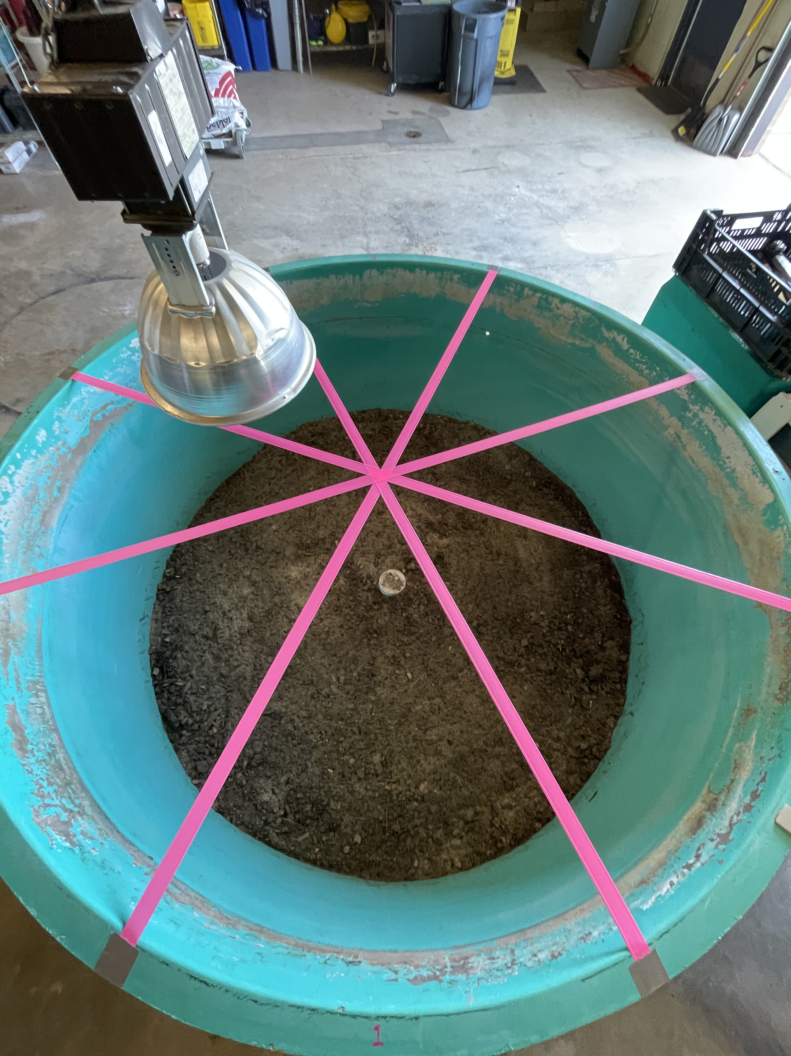
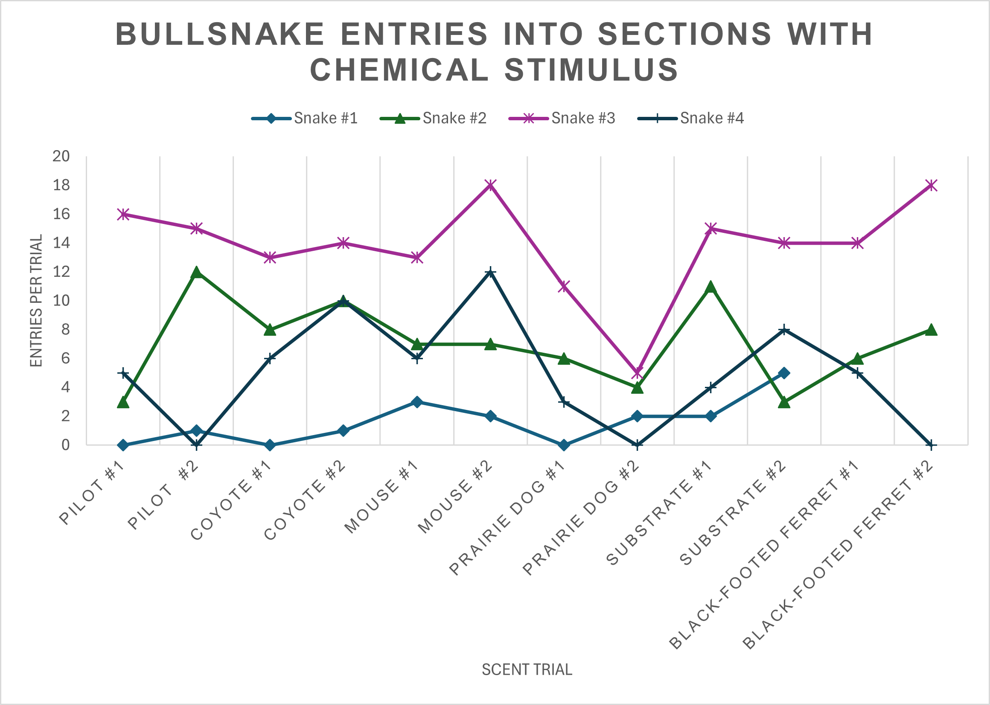
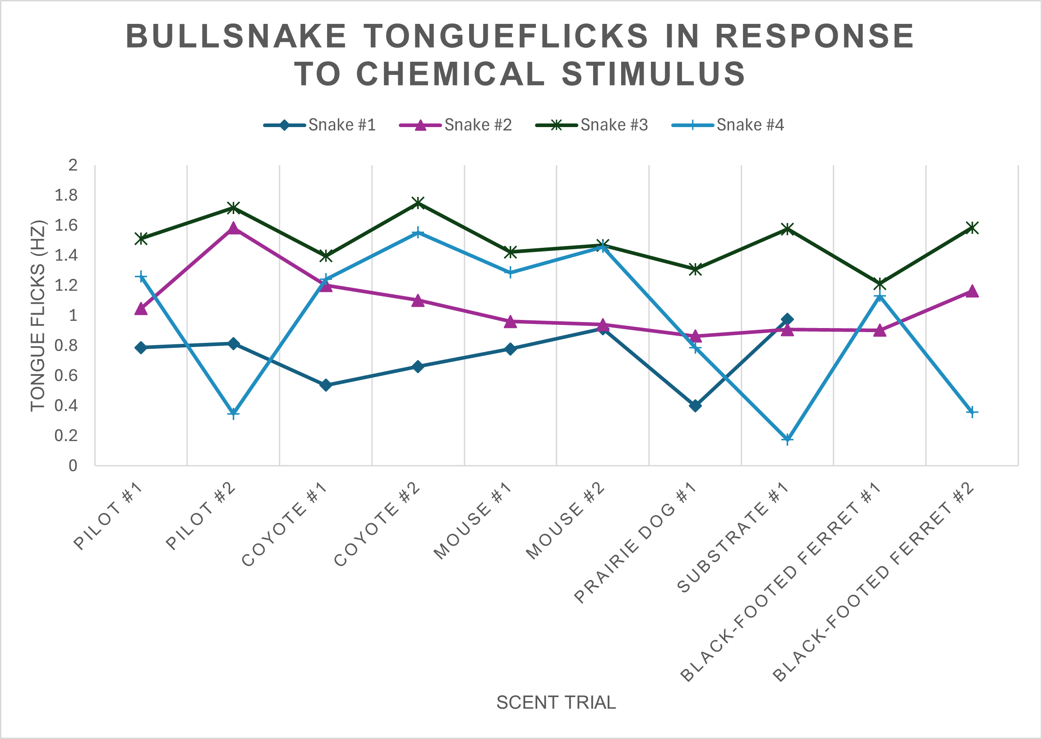
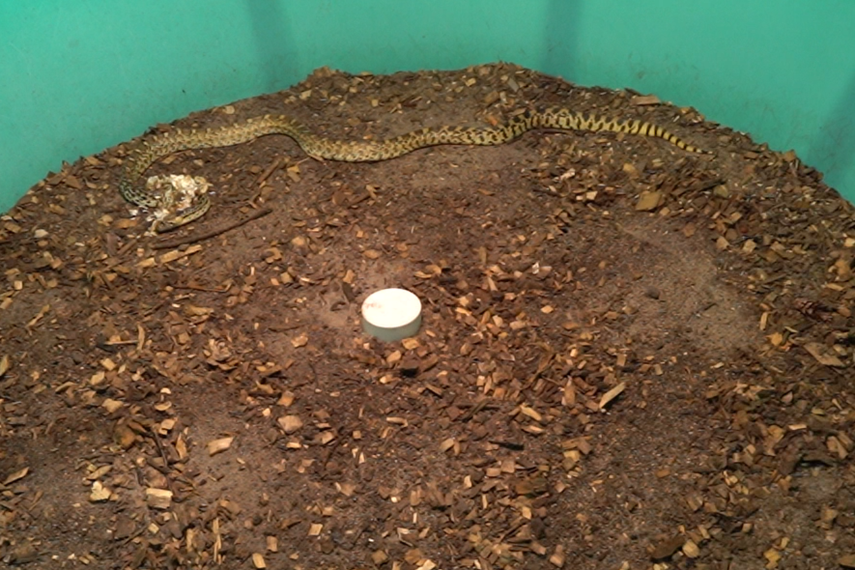
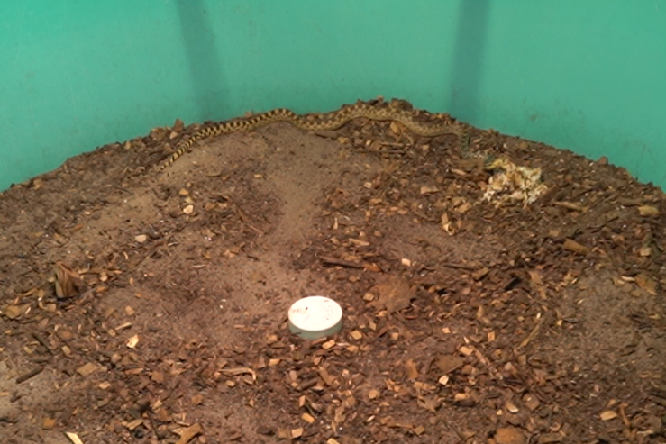
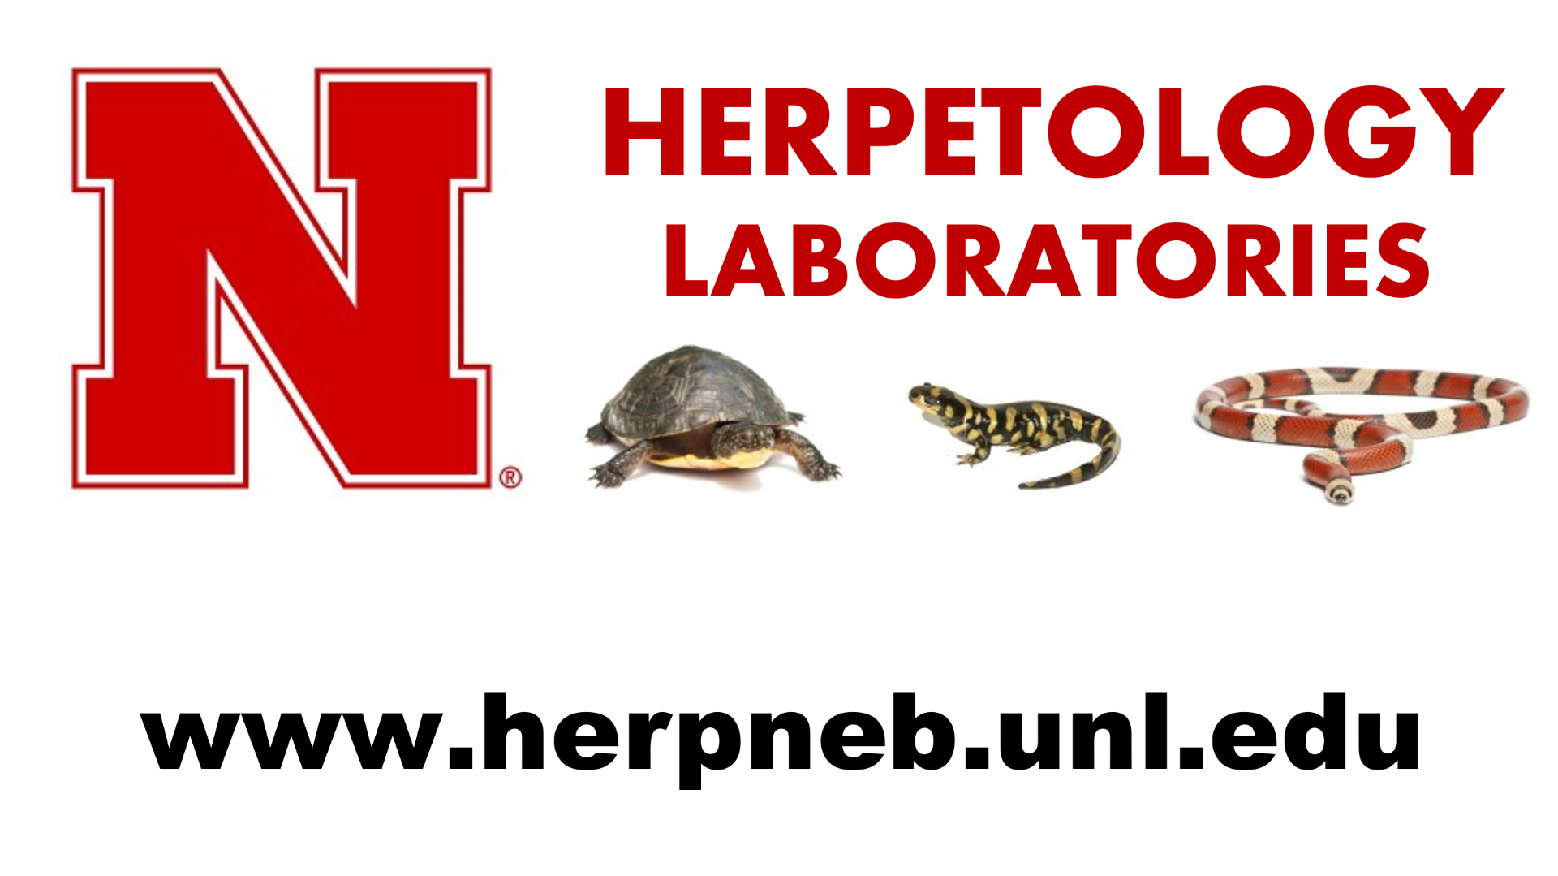

Investigating the Behavioral Responses of Bullsnakes (Pituophis catenifer) to Chemosensory Stimuli
Sarah Springer
School of Natural Resources
Background
Bullsnakes are a colubrid species of snake native to North America. They are generalists that prey on many species, and those that live in the Nebraska Sandhills often reside in abandoned prairie dog burrows. The mesopredator Black-footed ferret (Mustela nigripes) is a federally endangered species endemic to North America but has been extirpated from Nebraska. Black-footed ferrets are obligate carnivores of black-tailed prairie dogs (Cynomys ludovicianus) and are found in their towns, alongside bullsnakes, in pursuit of prey. Little is known about interactions between bullsnakes and black-footed ferrets, but investigation is warranted to determine if the snakes pose a realistic threat to ferret recovery. Snakes receive information about their environments through their vomeronasal organ. The vomeronasal organ is a chemosensory organ that transfers environmental chemical stimuli to the organ receptor during tongue flicking.
Methods
Four adult wild-caught bullsnakes were used in the study. All of them have been in captivity for five years or more. The trials were held in a circular arena separated into eight wedge sections. Every session lasted for a duration of 20 minutes. Selected chemical cues – coyote, black-footed ferret, black-tailed prairie dog, and mouse (Mas musculus) - were added to the arena before the snakes were individually introduced. Each trial, including a pilot and substrate-only trials, was repeated twice. The trials were videotaped with a Sony a7III camera, and each section the snake entered was recorded. The video footage was reviewed, and the number of tongue flicks per minute was documented. ANOVA testing in R-Studio was run to determine any significance between the number of times the scented sections were visited and the tongue flicks in response to the stimuli.
Discussion
The results stating that the data is statistically insignificant may be attributed to the small sample size and, therefore, the limited amount of data. Before the ferret trials began, Snake #1 unexpectedly passed away, reducing the sample size to three. The open arena allows for many behaviors to be exhibited and observed; it may also influence how the snakes respond to the stimuli. This may be a result of the open arena introducing other factors, such as scents and sounds, that may be distracting. Some behaviors exhibited by the snakes point toward an attraction toward black-footed ferrets, as seen in Fig. 3. as Snake #2 burrows through the scent pile. This study requires more research across a larger sample size to fully investigate the interest towards black-footed ferrets exhibited by bullsnakes.
References
Krause, M. A., Koharchik, C., & Staples, L. (2024). Responses to prey chemical cues in wild-caught, adult gopher snakes (Pituophis catenifer). Apa.org, 139(2). https://psycnet.apa.org/record/2025-20562-001 Pernetta, A. P., Reading, C. J., & Allen, J. A. (2008). Chemoreception and kin discrimination by neonate smooth snakes, Coronella austriaca. Animal Behaviour, 77(2), 363–368. https://doi.org/10.1016/j.anbehav.2008.10.008 Tretten, T. N. (2018). Rarely Observed Behaviors and Occurrences of Black-footed Ferrets Preconditioning for Wild Release 2014–2017. Journal of Fish and Wildlife Management, 10(1), 241–249. https://doi.org/10.3996/042018-jfwm-030
Fig. 1. The arena is a large, circular vessel split into even-sized wedges numbered one through eight, illuminated by an overhead light..
Results
The ANOVA results for both the bullsnake entries into sections with chemical stimulus and tongue flicks in response to chemical stimulus were statistically insignificant. Behaviors such as burrowing into and licking the scent piles were observed in the mouse and black-footed ferret trials.
Fig. 2. The number of entries of each snake into a section containing the chemical stimulus across all the trials.
Fig. 3. The frequency of tongue flicks per second from each snake observed across every trial.
Fig. 4. Snake #2 burrows through the ferret scent in the first black-footed ferret trial.
Fig. 5. Snake #3 burrows through the ferret scent in the second black-footed ferret trial.
Acknowledgements
I want to thank my mentor, Dr. Dennis Ferraro, for all his guidance and expertise throughout my project. I also want to thank Megan Soldatke, Platte Basin Timelapse, and Sarah Ulrichsen for their assistance and support.

