Slide 1

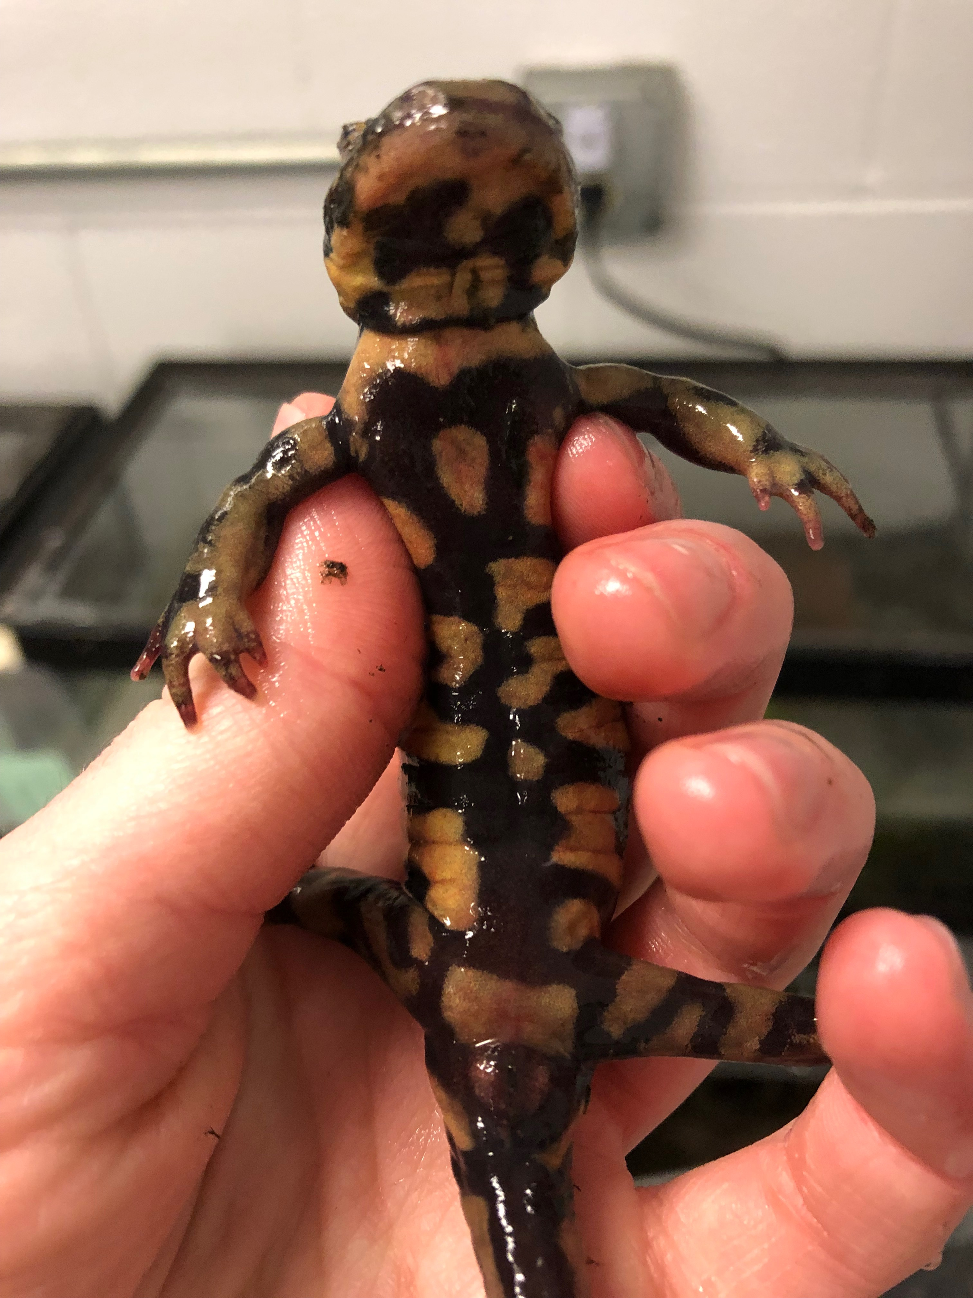
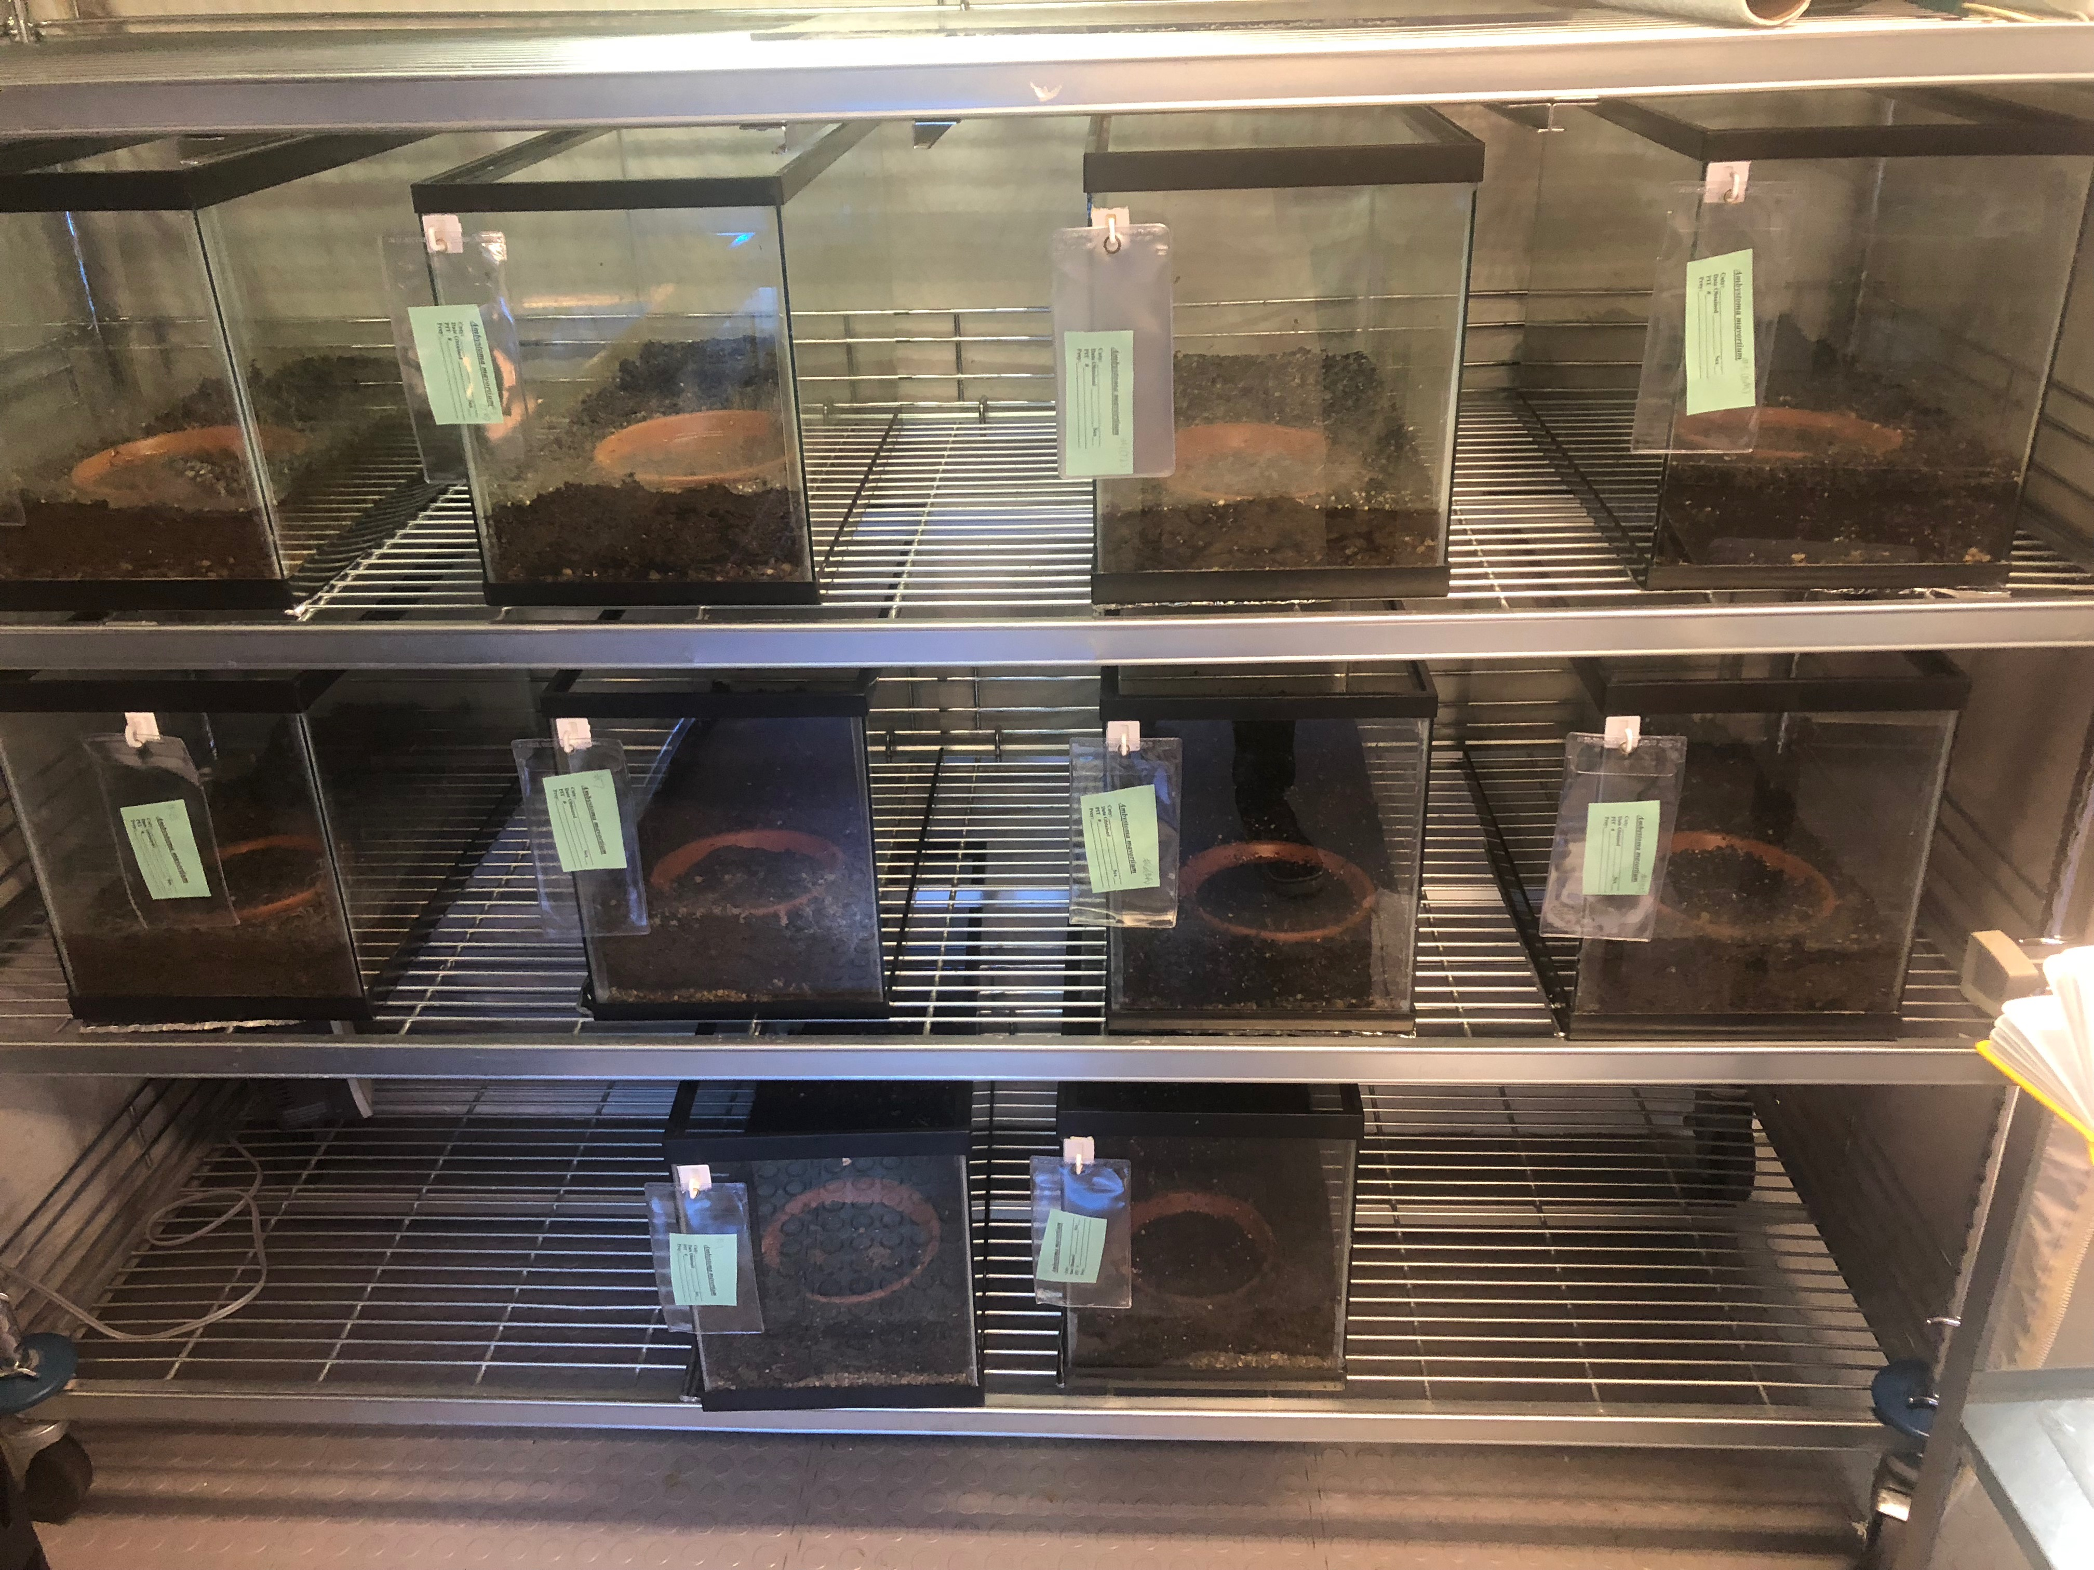
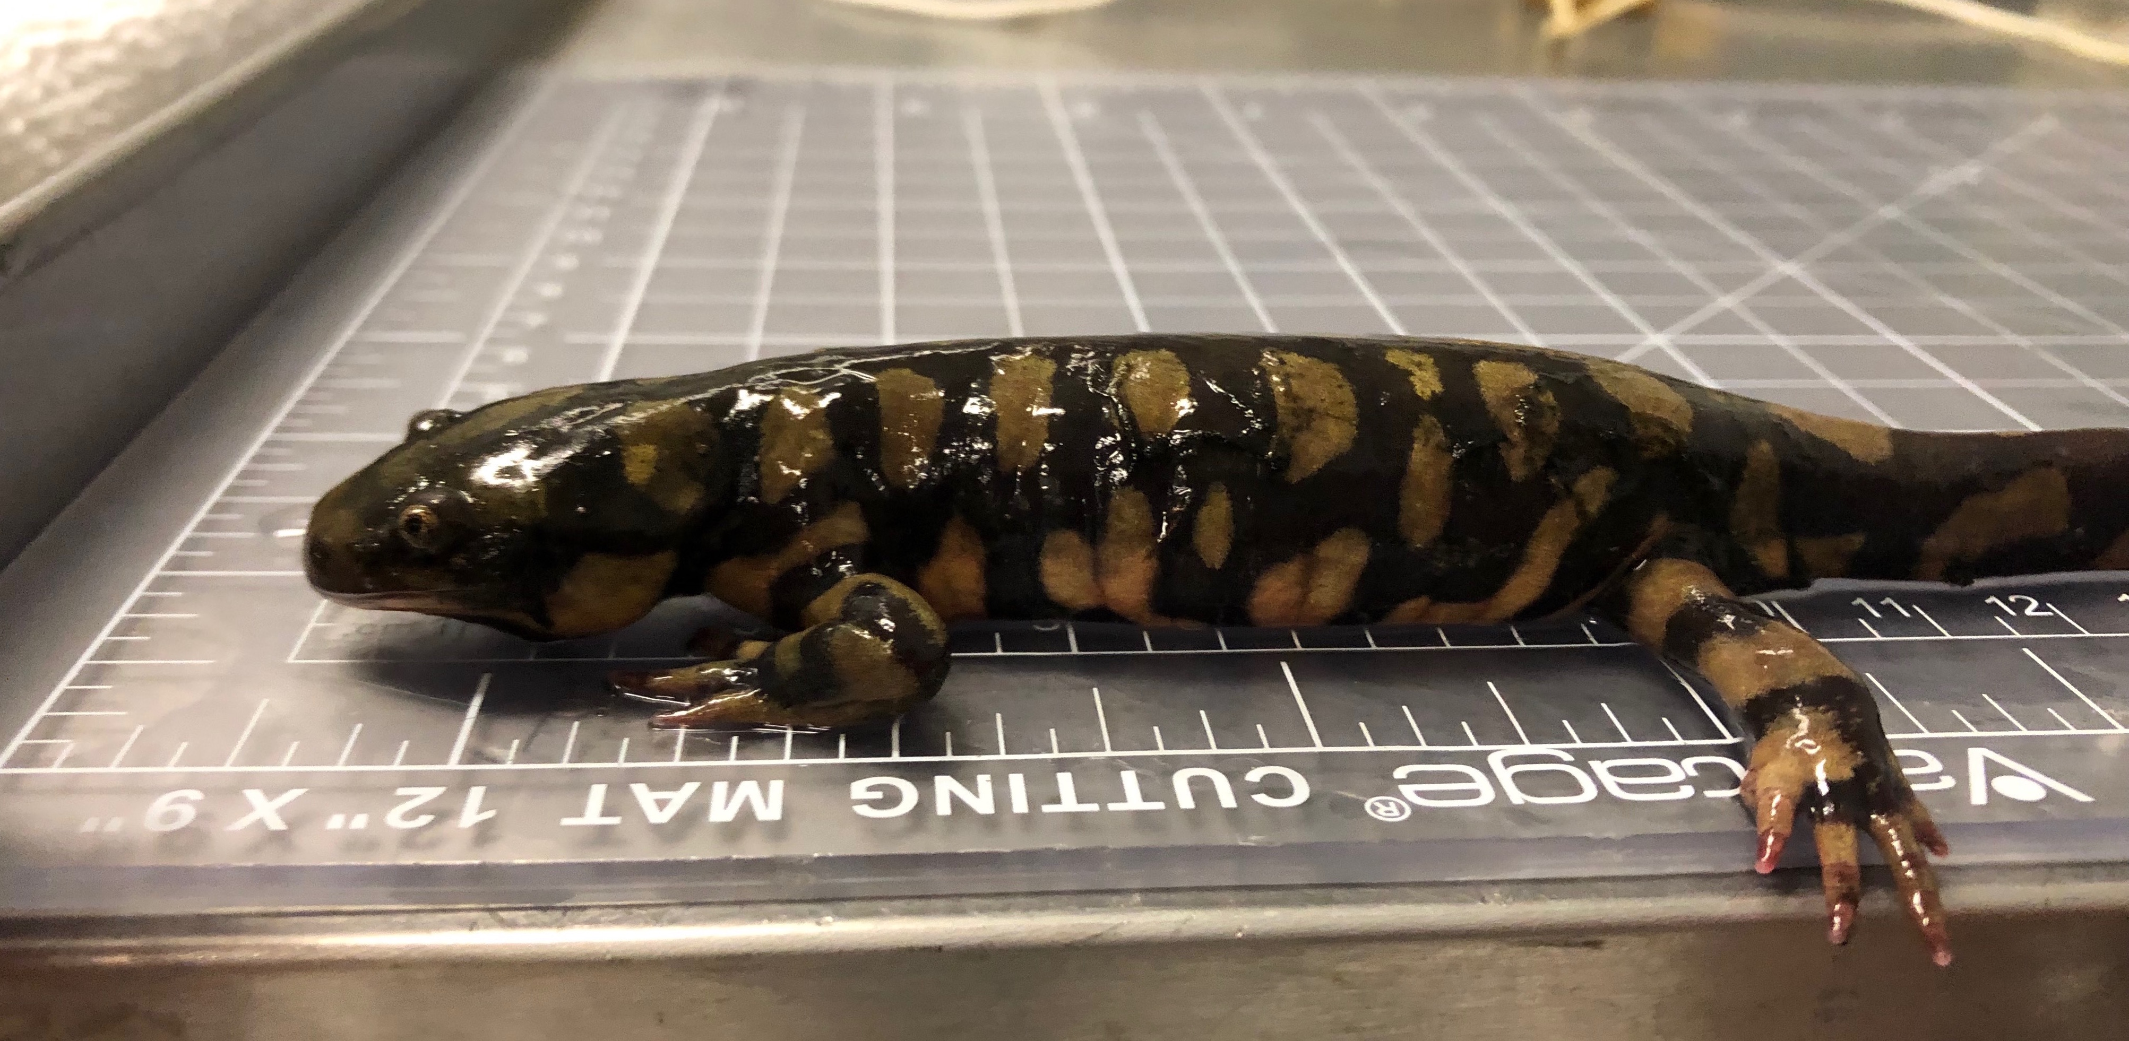
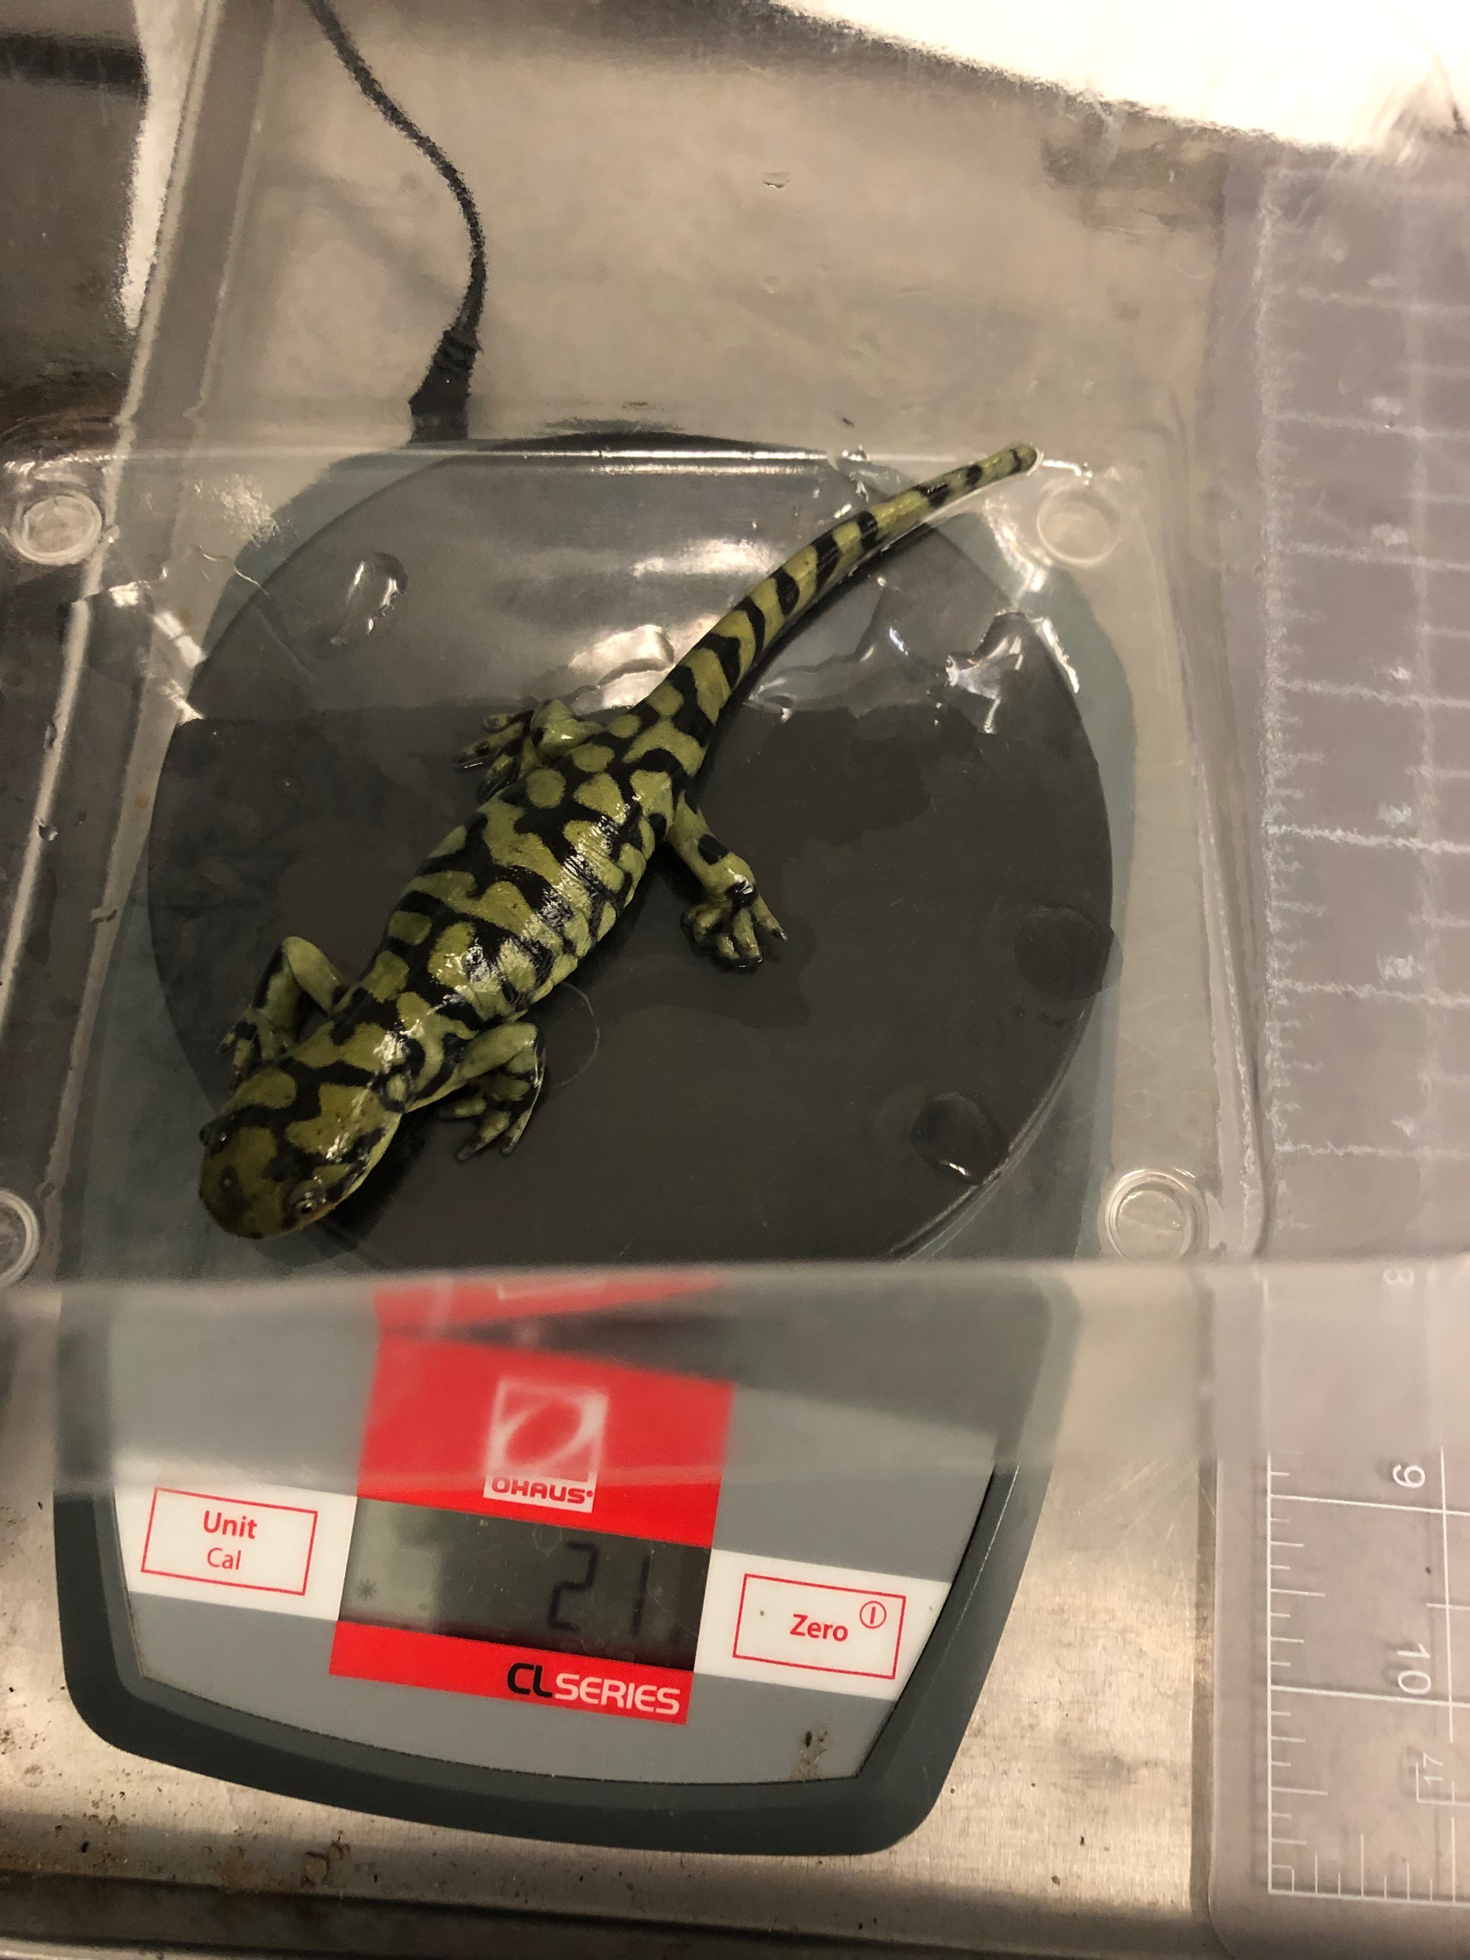
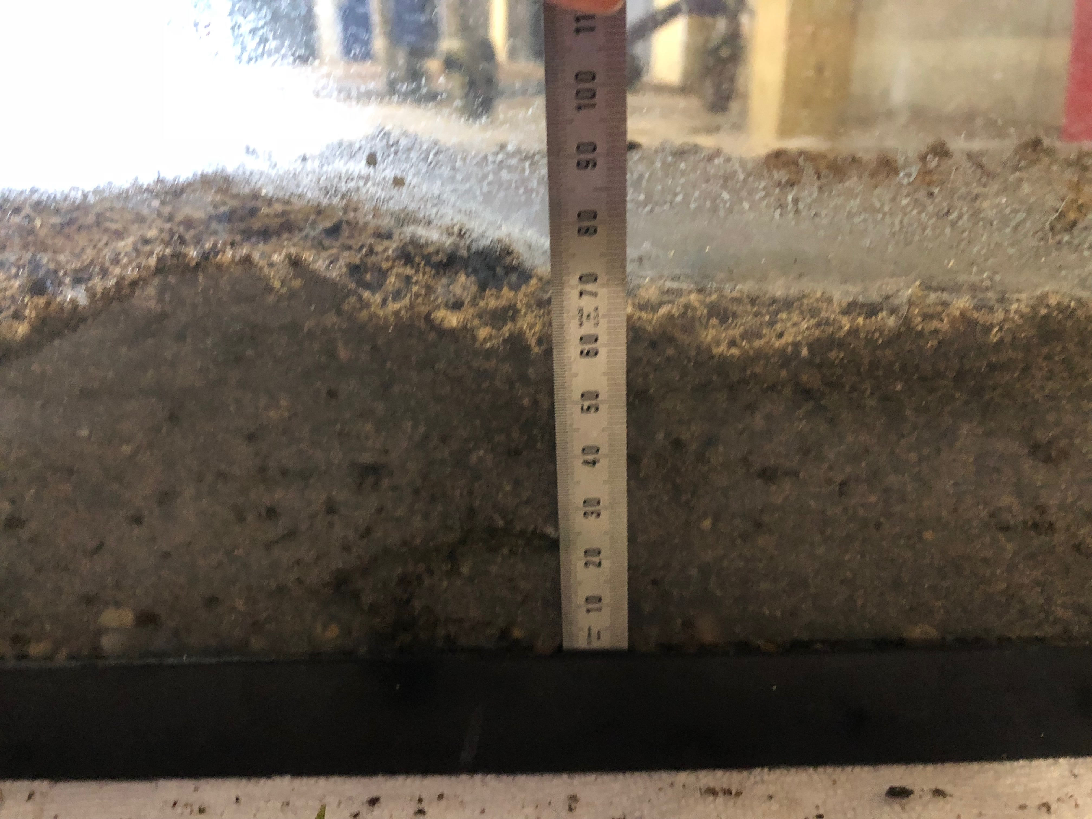
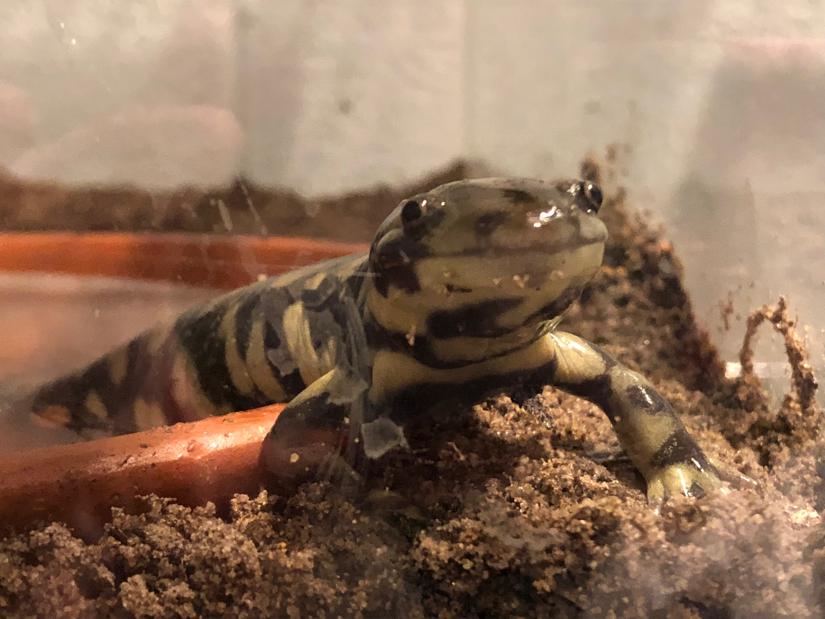
Western Tiger Salamanders (Ambystoma mavortium) Responses to Monoammonium Phosphate Soil Application Exposures
Lexy Polivanov and Dennis Ferraro
University of Nebraska-Lincoln
Introduction
Methods
Results
This study seeks examine the effects of current common components of agricultural and residential fertilizers, specifically monoammonium phosphate, on Western Barred Tiger Salamanders. The Western Barred Tiger Salamander is currently in decline in the Southeastern part of Nebraska (Ferraro, 2016). The salamanders have not seen a thriving population there in the last 5 years.
Amphibians play an important role as an indicator species. An indicator species is one that is affected by changes in the environment before other species. Amphibians absorb most everything from their environment through their skin. This makes amphibians especially susceptible to changes in the environment, especially chemical ones. They are good indicator of the general health of an ecosystem, and allow scientists to begin to pinpoint potential threats to other species as well as amphibians.
Set up
6 tanks (20 mm gravel; 80 mm soil)
160mm water dish
Soil moisture remained at a 7 or 8
20 ml of water added initially
Salamanders added as morphed
Weekly
Weighed
Snout-vent-length measured
3 times fed (red worms, tubifex, shrimp, and earthworms)
Testing
6 of 10 salamanders chosen based off feeding habits
3 control and 3 treatment
Fertilizer in the treatment
Ammonium phosphate was mixed in a 50 ml solution with R-O water
Rate of 2-10 lbs/square foot
2 lbs/square foot used
After winter break salamanders weighed once every 2 weeks
3 Salamanders died (1 control, 2 treatment)
#2 was severely red the week of its’ death
Average monthly weight gain
#1C= -.600
#2T= -.155
#3T= 2.085
#4C= .575
#5T= -.613
#6C= 1.163
The correlation coefficient between the treated and control salamanders at a significance level of .05 was .988.
Average control weight: 24.372
Average treatment weight: 26.928
The overall average weight reflects that both groups grew similarly despite the different treatments.
A .991 correlation coefficient was found between the average weights of the salamanders.
Salamander #2 showing redness 5 days before its’ death. It was in the treatment group and had been shedding that day. (above)
Salamander tanks in the lab. A cover was placed over them to keep them warm during the winter. (left)
Salamander #2’s snout-vent-length being measured in centimeters. (right)
Measuring approximately 80 mm of soil in the tank. (below)
Conclusion
A salamander halfway out of its’ water dish. This was taken prior to the treatments beginning. (below)
Due to small sample size more research will need to be done in order to find significant data. The correlation between the two groups of salamanders was high. Indicating that the monoammonium phosphate does not seem to affect weight gain of morphed salamanders. The fertilizer may have caused the redness on #2 as it was also shedding, other salamanders in the control shed and did not have red patterns.
References
Ashpole, Sara L., et al. "Unexplained Die-Off of Larval Barred Tiger Salamanders (Ambystoma Mavortium) in an Agricultural Pond in the South Okanagan Valley, British Columbia, Canada." Northwestern Naturalist, vol. 92, no. 3, Winter 2011, pp. 221-224. EBSCOhost, search.ebscohost.com/login.aspx?direct=true&db=aph&AN=70217316&site=ehost-live.
Ferraro, Dennis M., "Tiger salamanders disappearing in region" (2016). Faculty Publications in the Biological Sciences. 395. digitalcommons.unl.edu/bioscifacpub/395
Ferraro, Dennis M., “Amphibians, Turtles, & Reptiles of Nebraska.” (2018). University of Nebraska-Lincoln. snr.unl.edu/herpneb/. Accessed 11 March 2018.
University of Nebraska Lincoln (UNL). “Characteristics of Fertilizer Materials.” Plant and Soil Sciences Elibrary, 2018 passel.unl.edu/pages/informationmodule.php?idinformationmodule=1130447045&topicorder=3&maxto=7&minto=1. Accessed 11 March 2018.
Salamanders were weighed in a plastic container on top of the scale. The container was rinsed with R-O water and zeroed out on the scale. (above)

