Slide 1
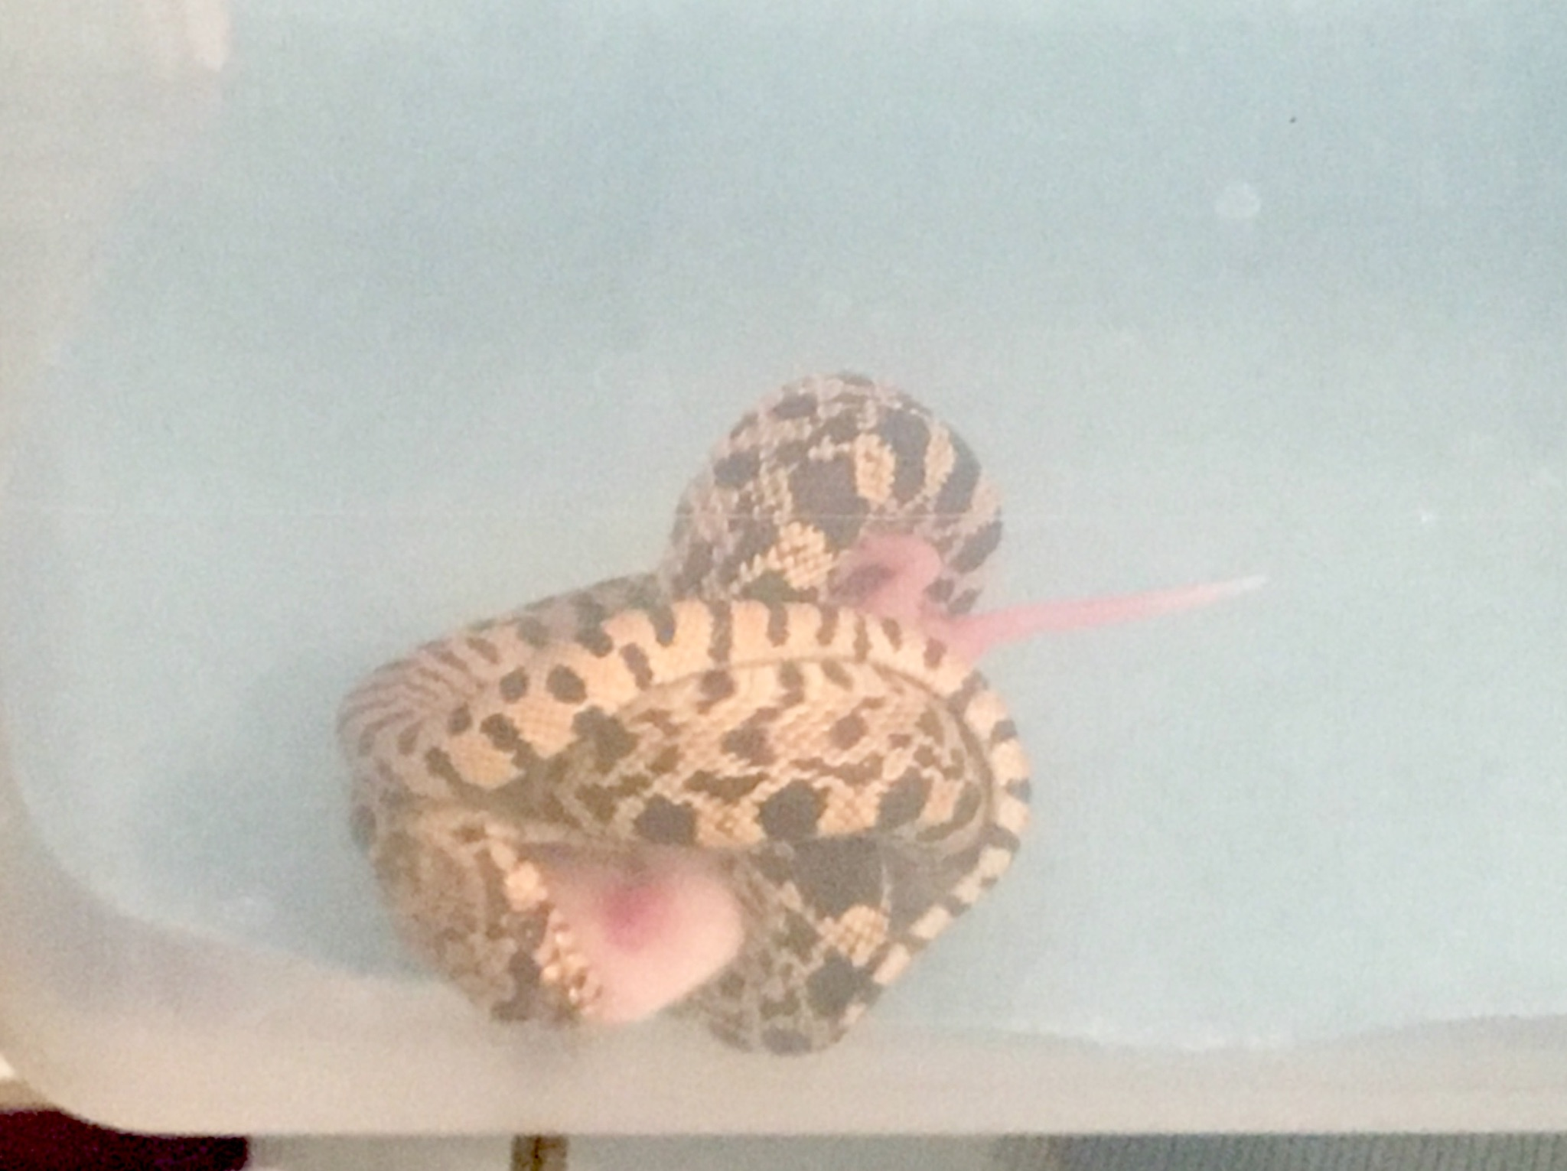
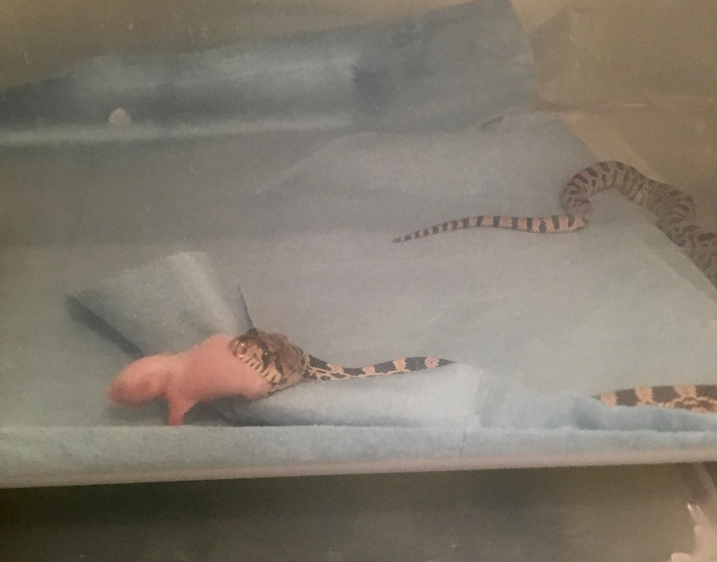
Feeding Methods for Headstarting in Bull Snakes (Pituophis catinefer)
Allison Carothers Adviser: Dennis Ferraro
Introduction
Bull snakes, Pituophis catenifer, are a Nebraska snake species that are crucial for a stable ecosystem. They eat mice and inadvertently ticks, which reduces the spread of tick-borne diseases. One technique that has been successful in the conservation of snake species is headstarting, which is the propagation and holding of a species to an age where it can be released into the wild and have a high probability of adding to the population. Headstarting is successful in snakes because they have no parental care and experience high juvenile mortality in the first year of life. When feeding captive snakes, two different husbandry methods can be used: feeding live mice, or frozen-thawed mice. Compared to live mice, frozen-thawed mice cost much less. The purpose of this project is to determine which feeding method, live or frozen-thawed mice produces the greatest weight gain in bull snakes. I hypothesized that snakes fed frozen-thawed mice will have a higher percent weight gain than snakes fed live mice due to the lack of needing to constrict to kill their prey.
Results
Discussion
My hypothesis was not supported. In figure 1, in five out of the six months, the snakes fed frozen-thawed mice had a higher percent weight gain than the snakes fed live mice, but the difference was not significant. This slight difference could be explained by the lack of constriction from the snakes fed frozen-thawed mice. Similar studies on constriction in different species of hatchling snakes have shown that snakes without constriction experience gain more weight than snakes with constriction experience (Penning & Dartez, 2016). These results have important animal husbandry implications for bull snakes in headstarting programs. Since live mice are significantly more expensive than frozen-thawed mice, and there was no significant difference in the weight gain between the two feeding methods, choosing to feed frozen-thawed mice could reduce the cost of headstarting programs while still prioritizing maximum hatchling health for success after release. An important aspect to note is the behavioral differences in the two groups of bull snakes. In the snakes fed frozen-thawed mice, there were 0 occurrences of constricting, and tail rattling occurred in 0% of feeding events. Additional research could be done to see if the lack of these behaviors during captive rearing will translate to lower fitness and success once released into their natural habitat. .
Figure 1: Percent weight gain after meals in snakes fed live mice vs frozen-thawed mice over approximately 30 day increments
Behavior Observations
Snake # | Tail Rattle | Constrict
Snake #1 | 92.9% | 8
Snake #2 | 64.3% | 4
Snake #3 | 7.1% | 5
Snake #4 | 42.9% | 4
Snake #5 | 0% | 0
Snake #6 | 0% | 0
Snake #7 | 0% | 0
Snake #8 | 0% | 0
Methods
Eight captive born snakes from wild caught adults were hatched at the UNL herpetology lab. Each week, snakes 1- 4 were fed live rodents, and snakes 5 – 8 fed frozen-thawed rodents of equal body weight and equal diet. Weight and length measurements were monitored every Tuesday before feeding and every other Friday to assess each snake’s growth and overall health. Since Pituophis catenifer secure its prey by coiling around it, whether or not each snake constricted during each feeding was recorded. During the first six recorded months the snakes were fed pinky mice which were fed only mother’s milk. During the last recorded month the snakes were fed older mice which were fed food that was not their mother’s milk.
Figure 3: Live fed snake with constriction
Literature Cited and Acknowledgments
Penning, David A., and Schuyler F. Dartez. “Size, but Experience, Affects the Ontogeny of Constriction Performance in Ball Pythons (Python Regius).” Journal of Experimental Zoology Part A: Ecological Genetics and Physiology 325, no. 3 (2016): 194–199. Dennis Ferraro UNL Herpetology Lab UNL UCARE Erica Lunde and David Izaquirre UNL IACUC [#1174]
Table 1: Percent occurrence of tail rattling during feeding days and number of times constricting was observed during feeding
Figure 4: Frozen-thawed fed snake with no constriction
UCARE

