Slide 1
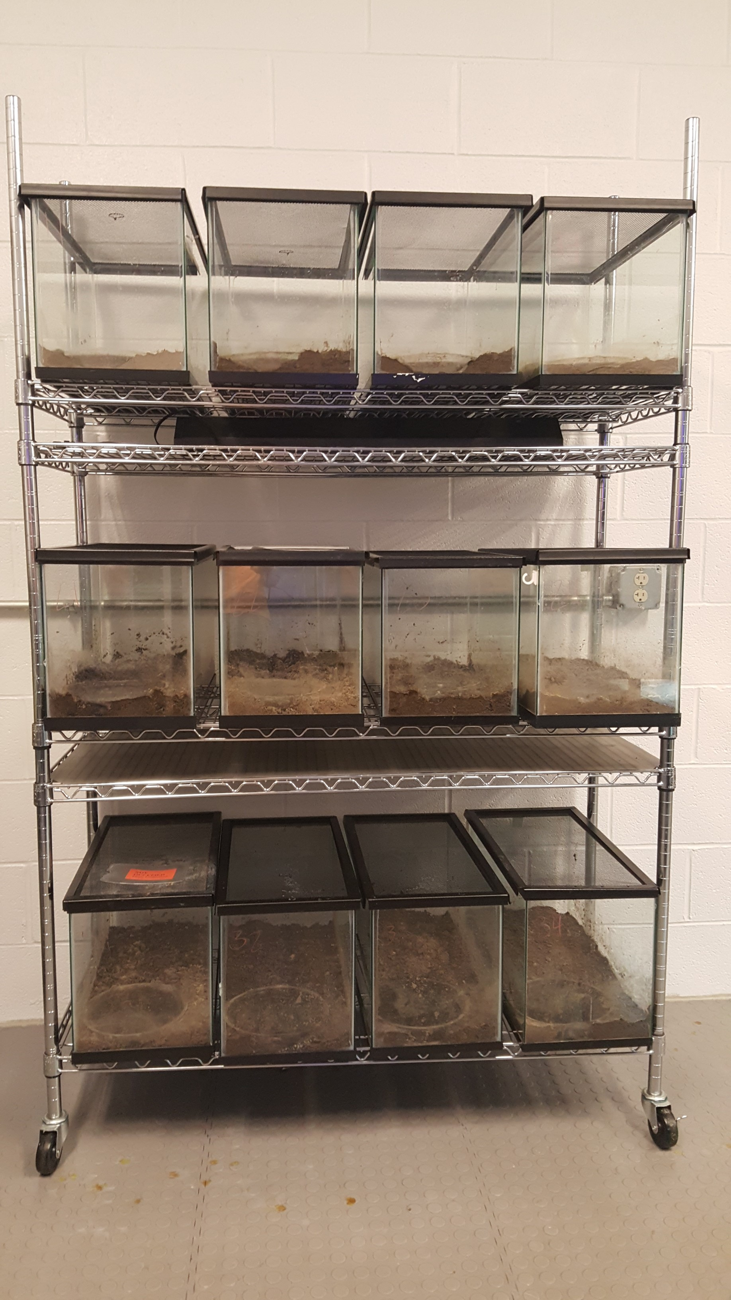
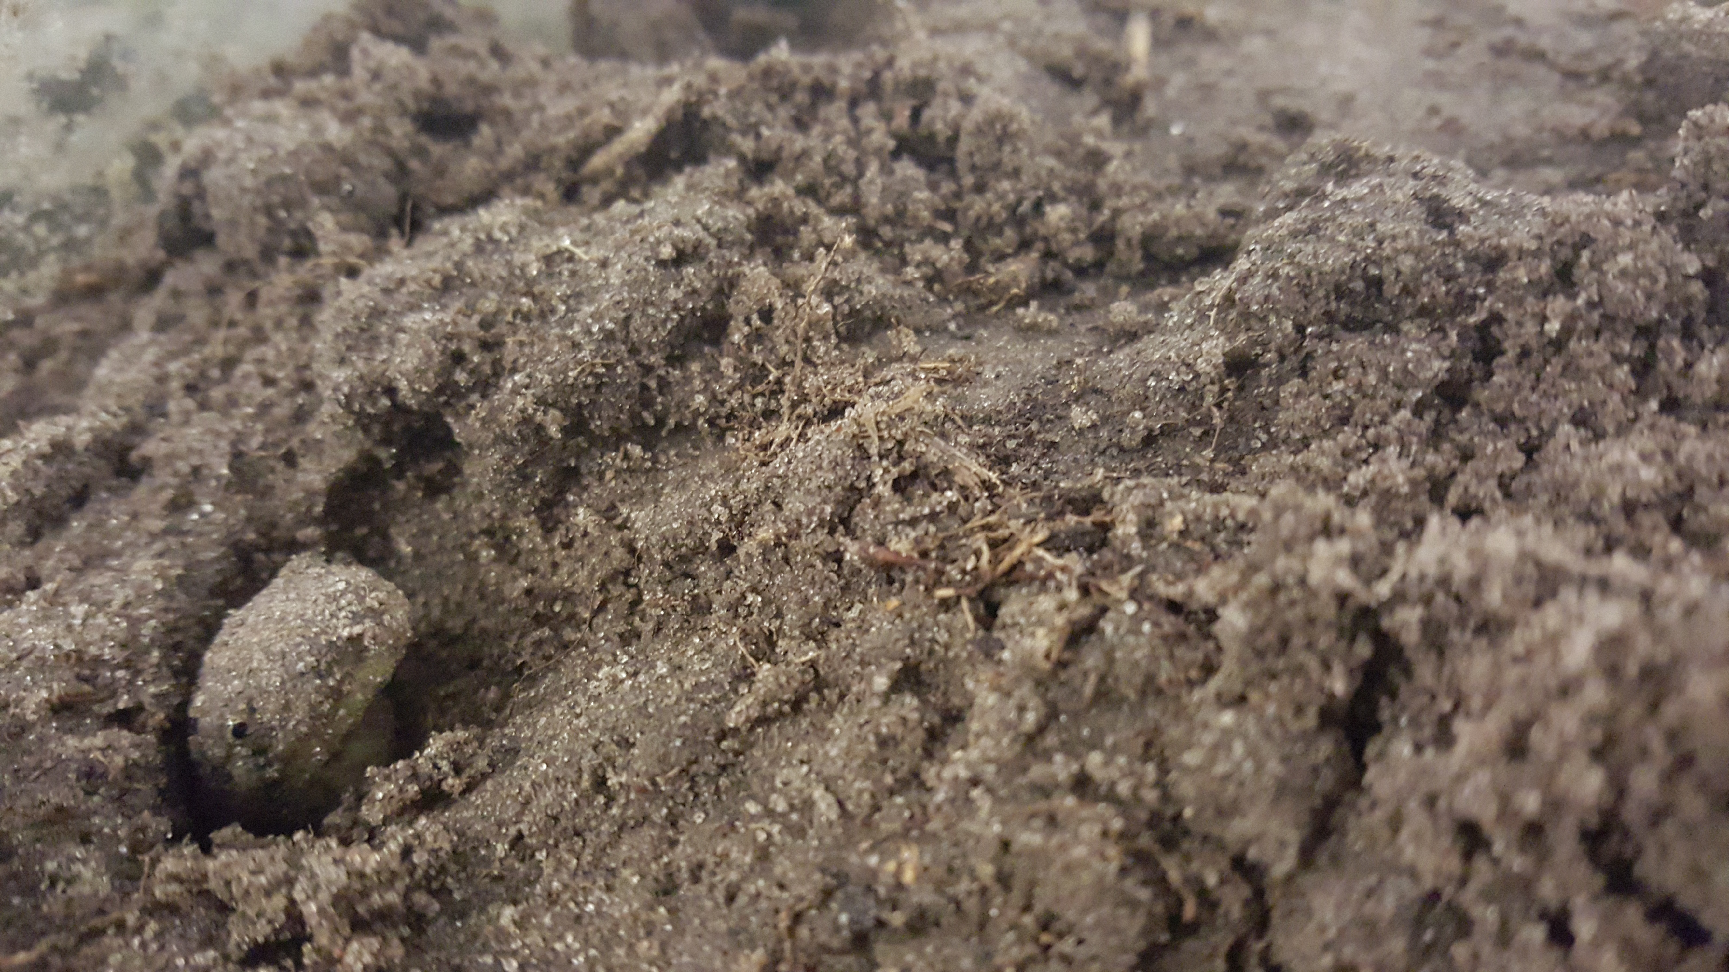
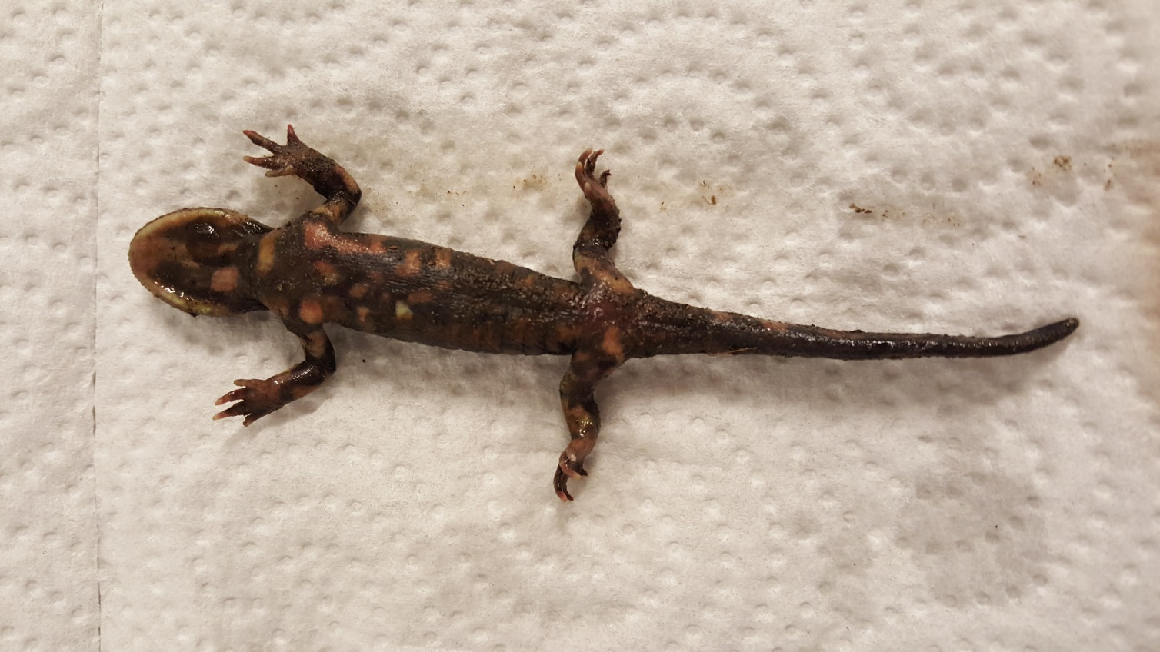
The Effect of Soil pH on the Integument of Salamanders
Aaron Devine Advisor: Dennis Ferraro
University of Nebraska - Lincoln, School of Natural Resources
Introduction
Results
Discussion
Western Tiger Salamander populations are declining in Nebraska, but oddly enough, only in the eastern side of the state.
Pollutants are expected to be a main culprit of salamander decline.
Amphibians are highly susceptible to environmental changes, primarily due to their semi-permeable skin.
Atrazine increases susceptibility of the tiger salamander to ranavirus (4).
Pollutants can leach into the ground, causing problems for many species, as well as aquifers and runoff into streams and lakes.. This contributes to poorer water quality, and water quality in some areas are linked to die-offs of salamanders (6).
Changes in water quality influence the Soil.
Many pollutants that cause drastic changes in pH can cause adverse effects for many species in an ecosystem, and pollutants that cause these changes have caused growth rate abnormalities, reduced survival and early hatching in amphibians (1).
Amphibians make great indicator species because of the impact that a relatively unimposing change on the environment can have on them. Very small changes within the environment can become detrimental to them, and can show early signs of ecological and environmental degradation.
This project looked to explain reasons why salamander populations were doing poorly in parts of Nebraska.
This research was meant to determine that pH of the soil and integumental injuries were correlated and if they were indeed playing a part in the decline of the salamander.
This looked to uncover if pH in soil played a role in the decline of the western tiger salamander population.
Because their skin is semi-permeable, nearly any environmental change not perfectly fit for the animal can cause it harm
Throughout the study it was observed that lower, more acidic pH’s did in fact have a link to impacts on salamander integument.
Lesions were not found to be related, but redness of skin did correlate with a decreasing level of pH in the soils.
One study indicates that amphibian decline is most likely due to multiple factors, such as invasive species, fragmentation, acidic deposition, and pesticide use (2).
Because of this connection, there is a higher likelihood that pH change is one of the issues affecting the western tiger salamander in the eastern part of the state.
This pH change may not only impact the salamander, but it’s habitat as well as it’s predators or prey.
Can throw off ecosystem balance if salamander or species lost is important enough to ecosystem equilibrium. Brodman et al (3), found that there was a correlation between pH change and trophic cascade involving amphibians as predators.
Various forms of lesions have been found on salamanders in areas with high sewage pollution (7). Data observed in this study can correlate with Rose’s (7) study, showing that in areas with pollutants that cause a lower pH, integumental effects similar to lesions can occur, especially by reddening of the skin.
The unfortunate complexity of how amphibians are impacted by many factors of environmental change results in much of this research needing to be extended or coupled with several other projects.
Looking at impacts of embryonic development might be a good addition, as that is a prime issue with low pH’s elsewhere (5), and could be a potential issue with what is occurring in Nebraska with salamanders
This project could have been done by studying behavioral effects of the salamanders as well, as there might be behavioral implications that may have attributed to the decline in Eastern Nebraska related to pH change.
When at a lower pH, the salamander is obviously affected to some degree, but other behaviors were not studied. Some salamander species have shown behavioral reactions to decreased pH, such as impaired eating (8), and these ambystomid salamanders may have similar reactions.
Graph
Shows the average pH of each container from November to March- Some data skewed.
Two salamanders died and pH of row 3 never got to the expected pH of 4-5.
Figure 1.
Shows percentage of various effects of pH change in first trial
Control had response to fungus
Salamander in row 3 died before first trial
Figure 2.
Shows percentage of various effects of pH change in second trial
Salamander in row 2 died, covered in mulch when found
Control continued to show signs of fungal problems
Figure 3.
Shows percentage of various effects of pH change in third trial
Salamander in row 1 started to show redness on skin
Methods
Literature Cited
Larval salamanders collected spring of 2015 from Cherry Co, NE.
Three test groups set up with four containers in each group.
Mulch was mixed with soil to keep it from drying out.
3 different pH levels were determined using acid solution, 6-7 (Control), 5-6. and 4-5.
Data recorded in November-February using pH meter & observation of integument.
Bradford, David F., Cristina Swanson, and Malcom S. Gordon. “Effect of Low pH and Aluminum on Two Declining Species of Amphibians in the Sierra Nevada, California.” JSTOR. Society for the Study of Amphibians and Reptlies, Dec. 1992. Web. 1 Sept. 2015.
Bradford, David F., Malcolm S. Gordon, Dale F. Johnson, Russell D. Andrews and W. Bryan Jennings. “Acidic Deposition as an Unlikely cause for Amphibian Population Declines in the Sierra Nevada, California.” Elsevier, 1994. Web. 1 Sept. 2015.
Brodman, Robert, W. Dan Newman, Kristin Laurie, Sarah Osterfeld, and Nicole Lenzo. “Interaction of an Aquatic Herbicide and Preditory Salamander Density on Wetland Communities.” JSTOR. Society for the Study of Amphibians and Reptiles, Mar. 2010. Web. 06 Mar. 201%.
Forson, Diane Denise and Andrew Storfer. “Atrazine Increases Ranavirus Susceptibility in the Tiger Salamander, Ambystoma Tigrinum. “JSTOR. Ecological society of America, Dec. 2006. Web. 06 Mar. 2015
Ireland, Patrick, H. “Separate Effects of Acid-Derived Anions and Cations on Growth of Larval Salamanders of Ambystoma Maculatum.” JSTOR. American Society of Ichthyologists and Herpetologists, 7 Feb. 1991. Web. 7 July 2015.
Ryan, M.E., Johnson, J.R., Fitzpatrick, B.M., Lowenstine, L.J., Picco, A.M. and Shaffer, H.B. (2013). “Lethal effects of Water Quality on Threatened California Salamanders but not on Co-Occuring Hybrid Salamanders.” Conservation Biology, 27: 95-102. 2013. Web. Mar. 2015.
Rose, Francis L. “Tissue Lesions of Tiger Salamanders (Ambystoma Tigrinum): Relationshiop to Sewage Effluents.” Wiley. Wiley, 16 Dec. 2006. Web. 2 Sept. 2015
Roudebush, Roger E. “A Behavioral Assay for Acid Sensitivity in Two Desmognathine Species of Salamanders.” JSTOR. Herpetologists’ League, Dec. 1988. Web. 23 July 2015.
Special thanks to Dennis Ferraro (Thesis Advisor), Dr. John Carroll (Thesis Reader), Dr. Dave Gosselin (Environmental Studies Program Director), UCARE
UCARE

