Slide 1
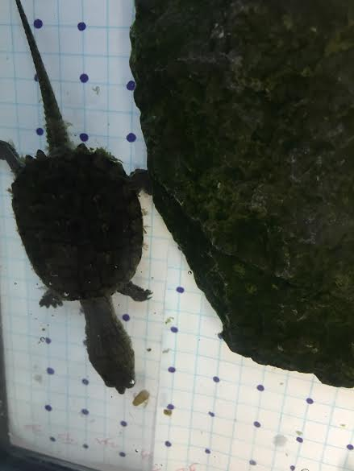
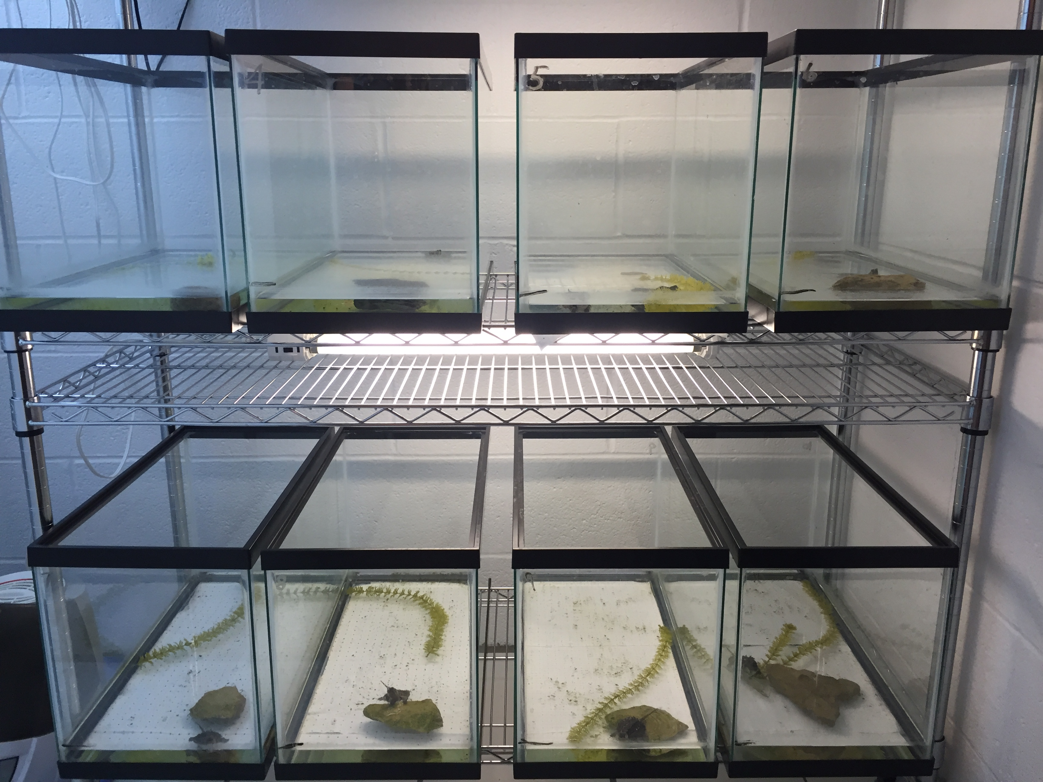
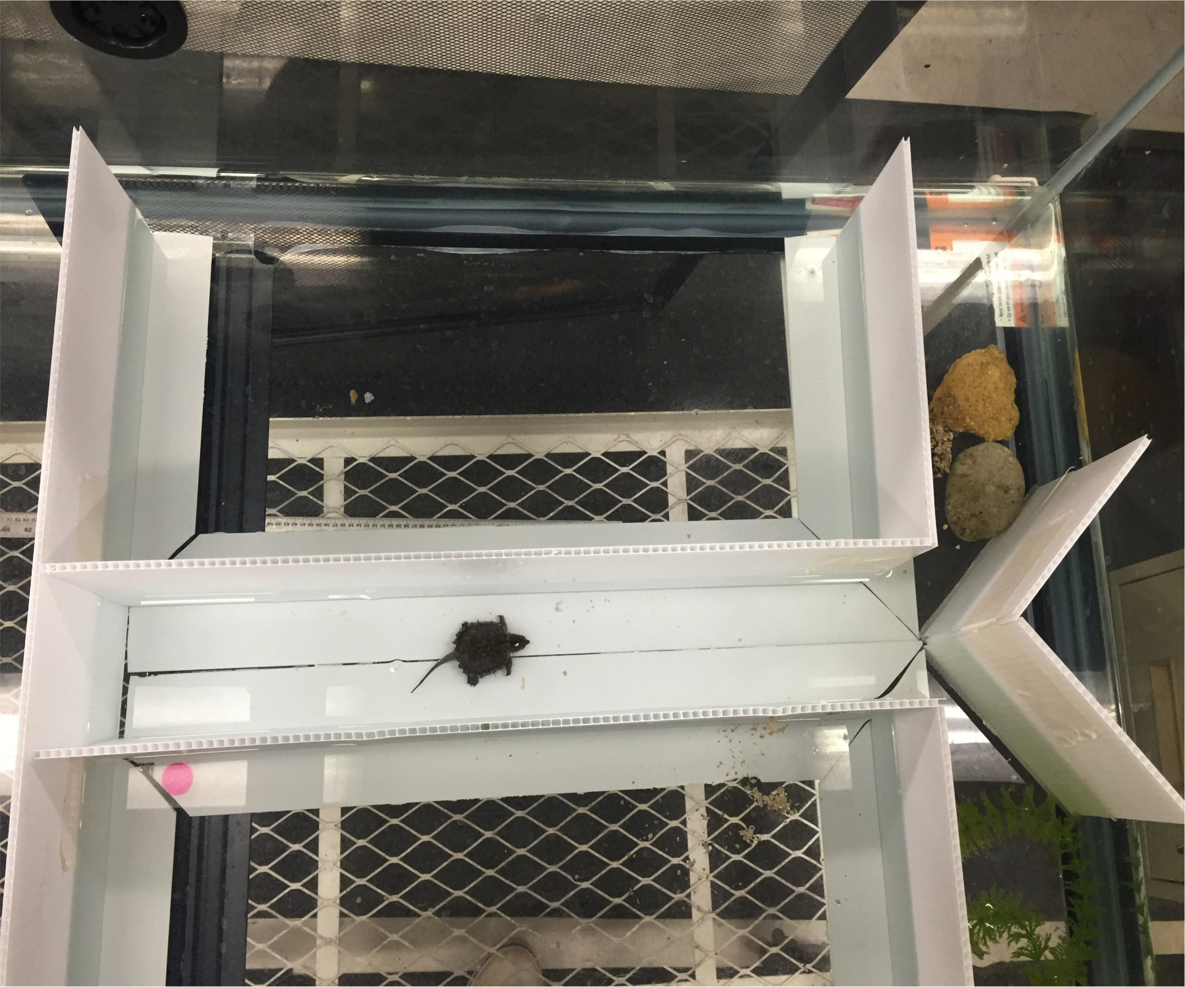
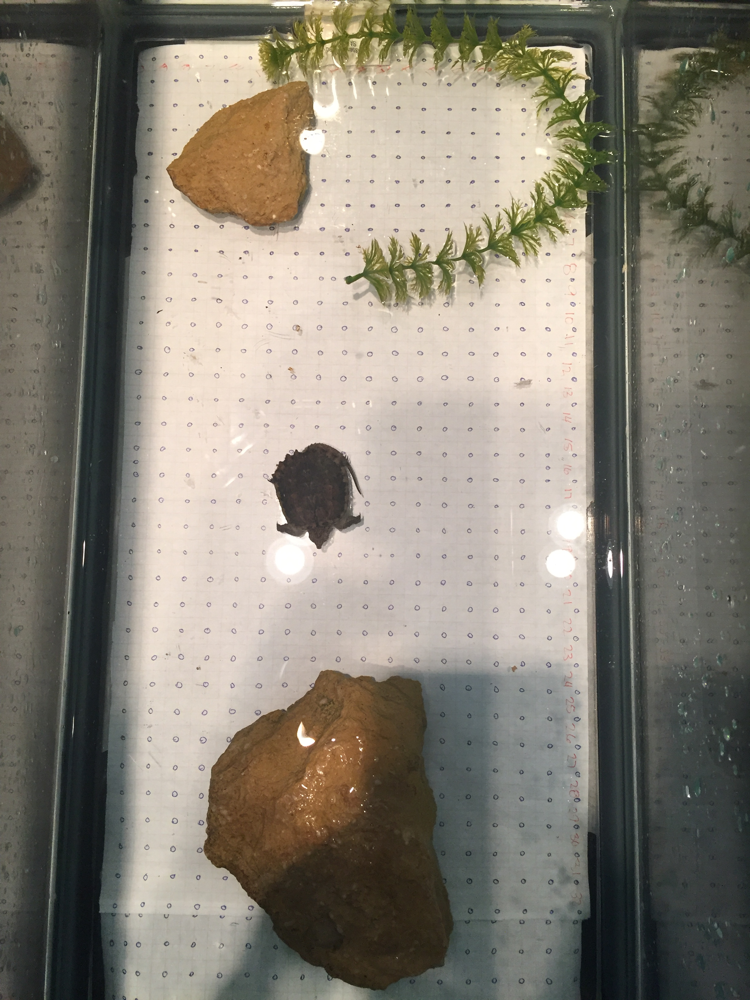
Cognitive Learning in Hatchling Common Snapping Turtles
Alli Hough Advisor: Prof. D. Ferraro
Introduction
In the field of wildlife research, cognitive studies are often overlooked. Physical characteristics such as diet and reproduction are considered more important than cognition. Recent studies show that cognition may be more important to conservation than once believed. Studying how turtles think and navigate their environment can have many implications on conservation decisions.
The objective of this study was to determine what cues snapping turtles use to navigate their environment and find resources.
Observational Results
Results, while contrary to objective, furnished many interesting observations that warrant further study. The turtles seemed to recognize my hand and the forceps more than any particular location for their food. This caused problems in studying spacial cognition as they wanted to follow my movements as opposed to searching out their food and learning the environment.
Methods
The second series of trials used a grid system, pictured on the right. The turtles were fed in the same location on the grid each time. Once they learned where to find the food in the tank, changing the cues within the environment. Determination of whether or not the subjects were using this visual cues to navigate their environment.
Initial trials used a simple T-maze, pictured above. Each side of the maze contained a different visual cue, rocks on one side and plants on the other. The turtles were fed on the same side of the maze each time. Once the turtles learned the maze, the cues are changed to analyze how these changes affect their ability to navigate the maze.
Discussion
While the objective of the study was not met during this study period, the time spent was by no means wasted. Traditional cognition tests such as mazes have been ruled out, and several new research questions have been brought to light. Further study on spatial cognition in aquatic turtles is necesary to find how these animals think.
Acknowledgements
UNL UCARE program
UNL HERPETOLOGY Lab. & Dennis Ferraro
UNL IACUC
Mr. Chris Vissar
UCARE

