Slide 1
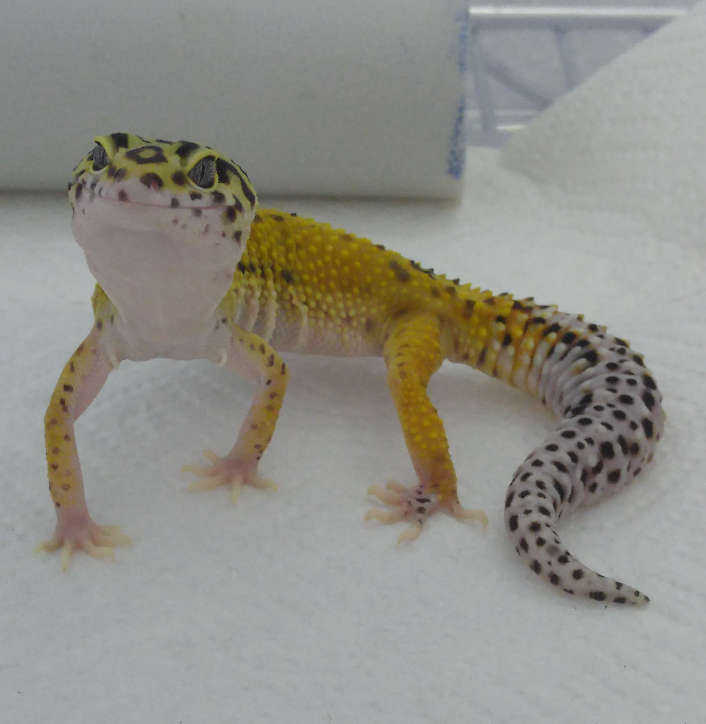
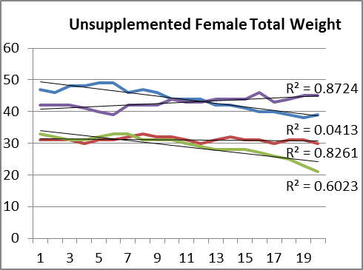
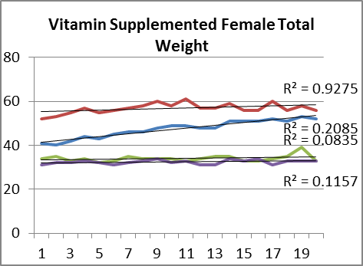
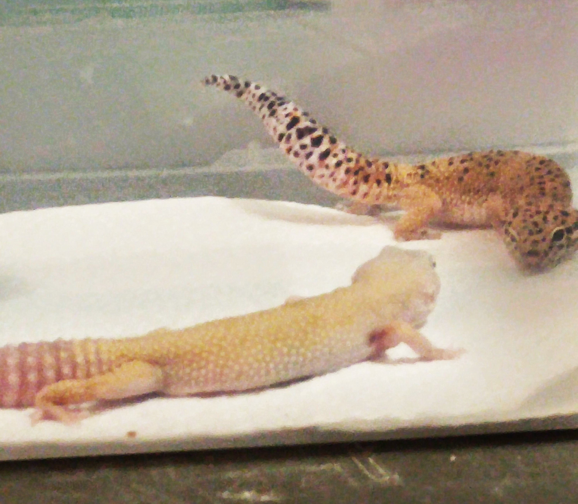
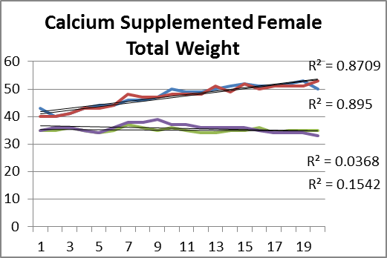
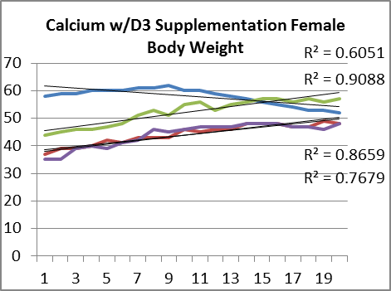
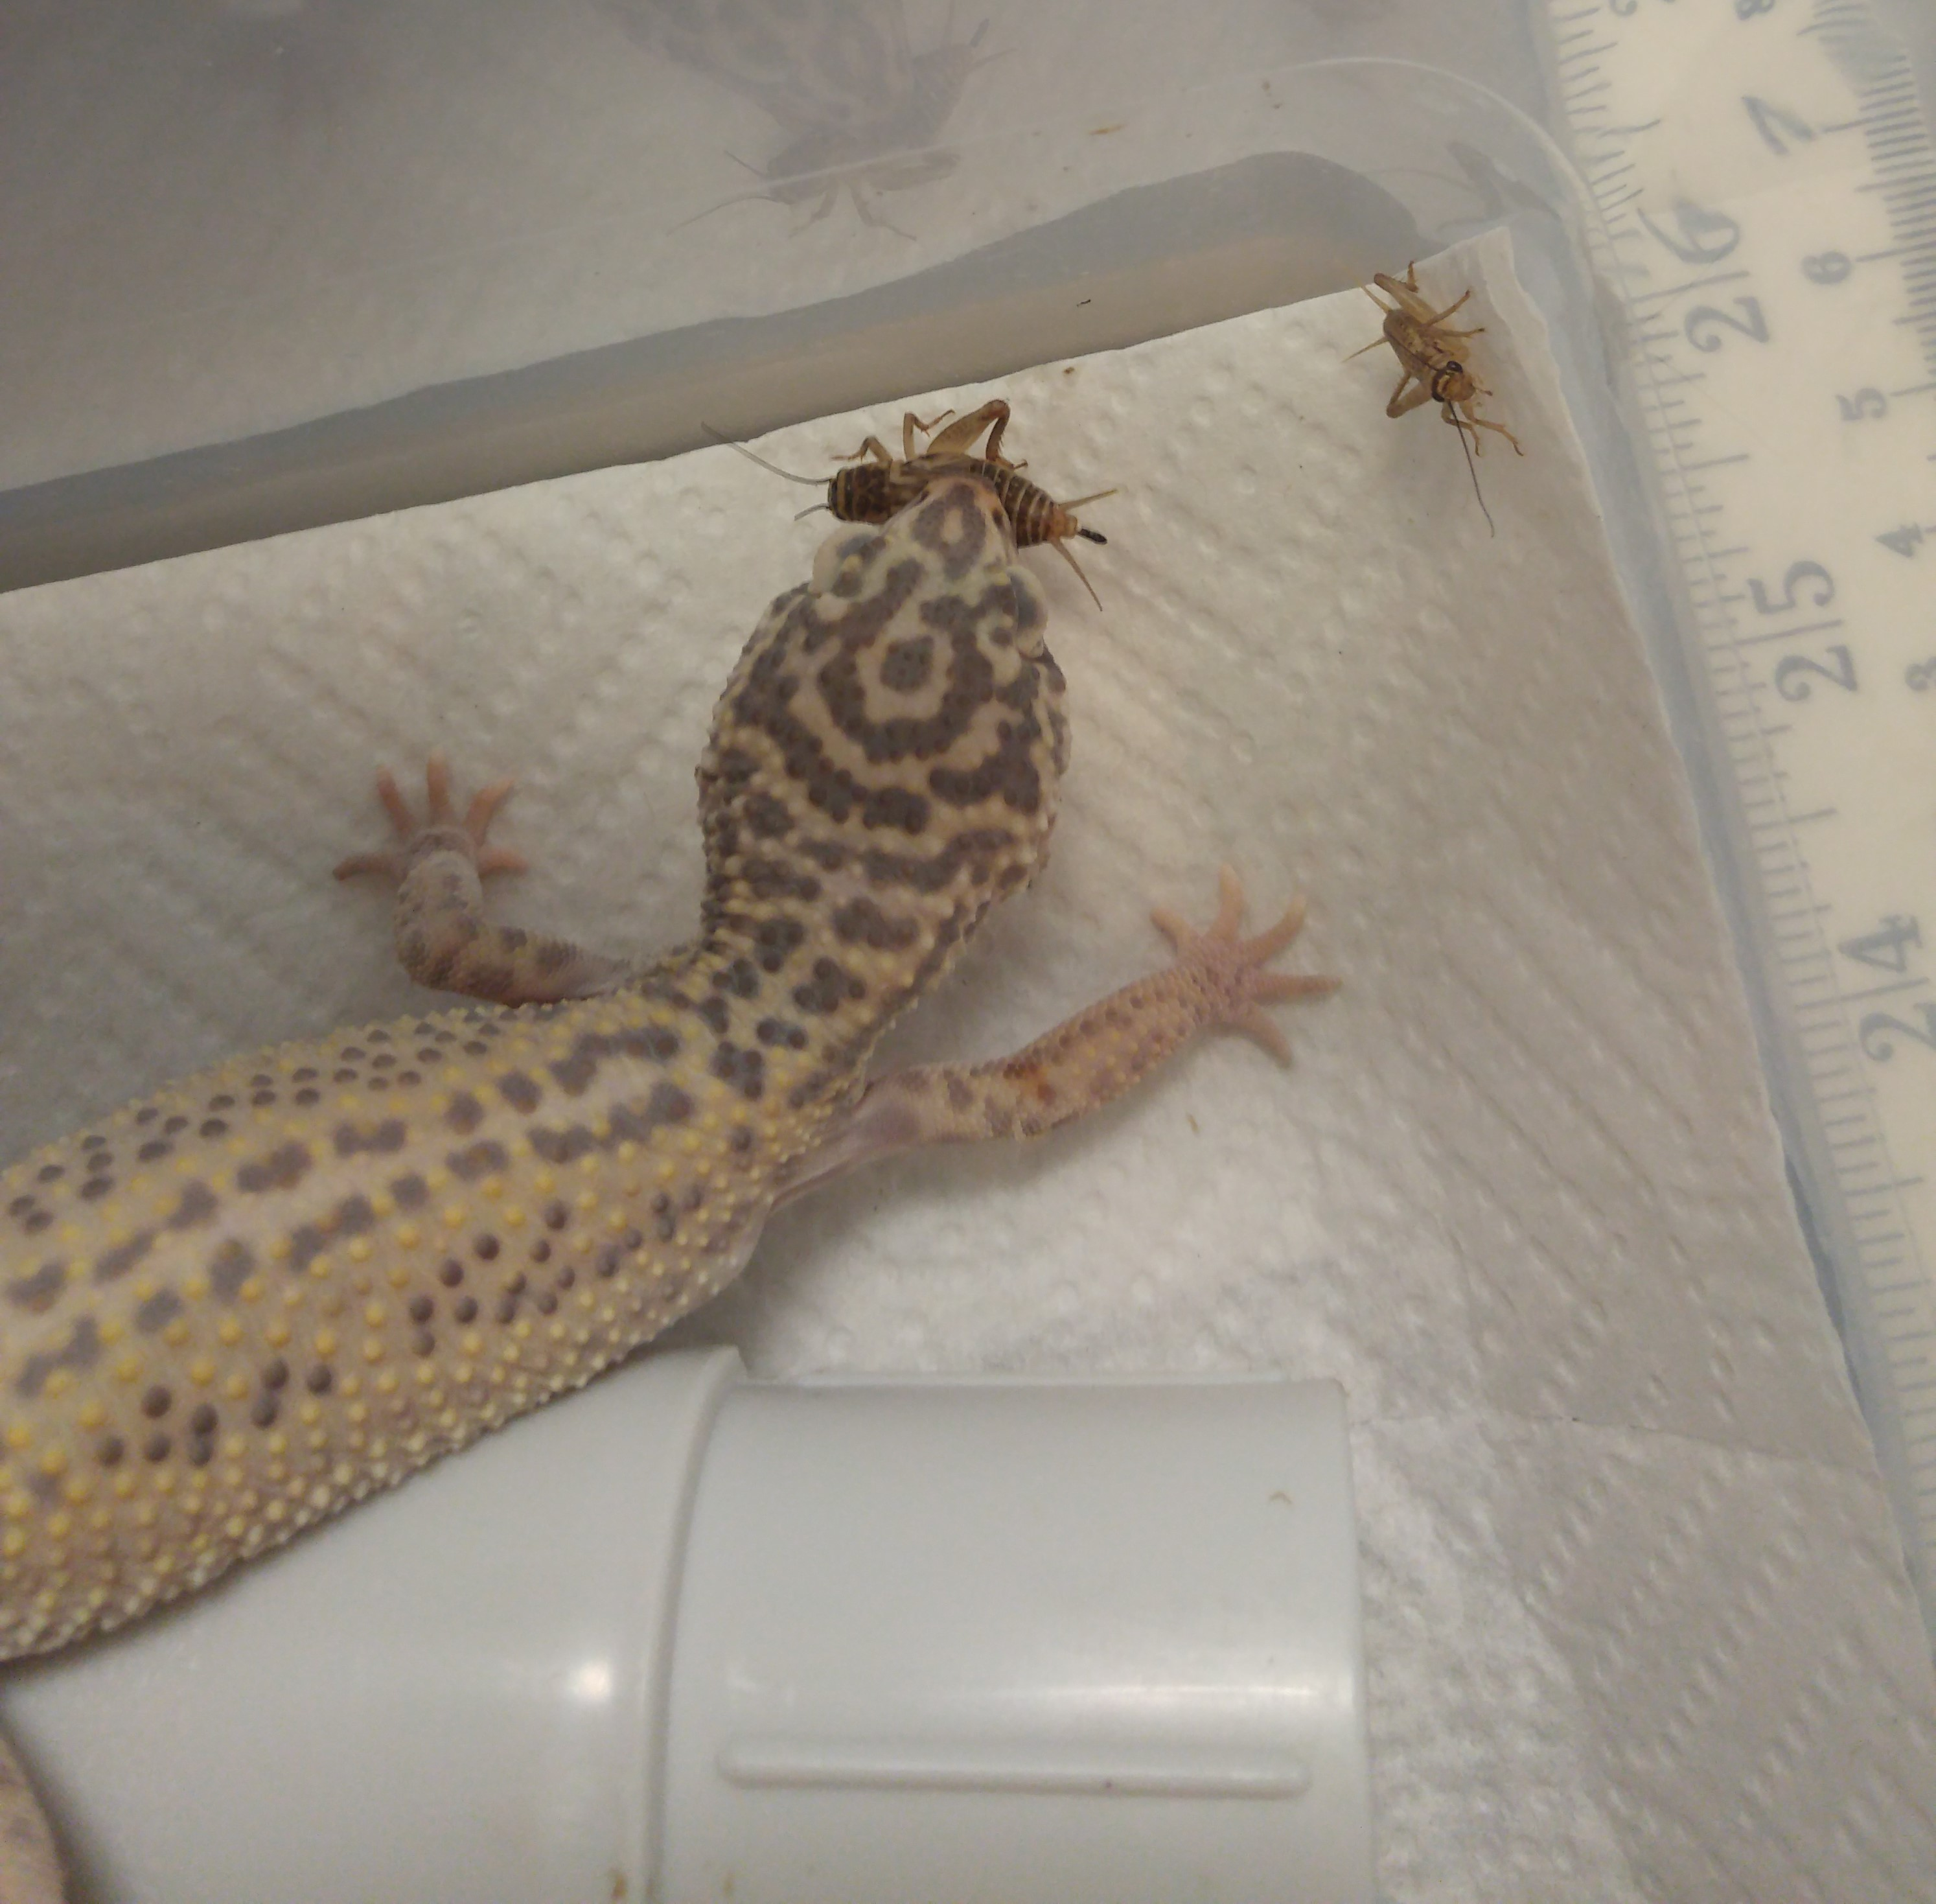
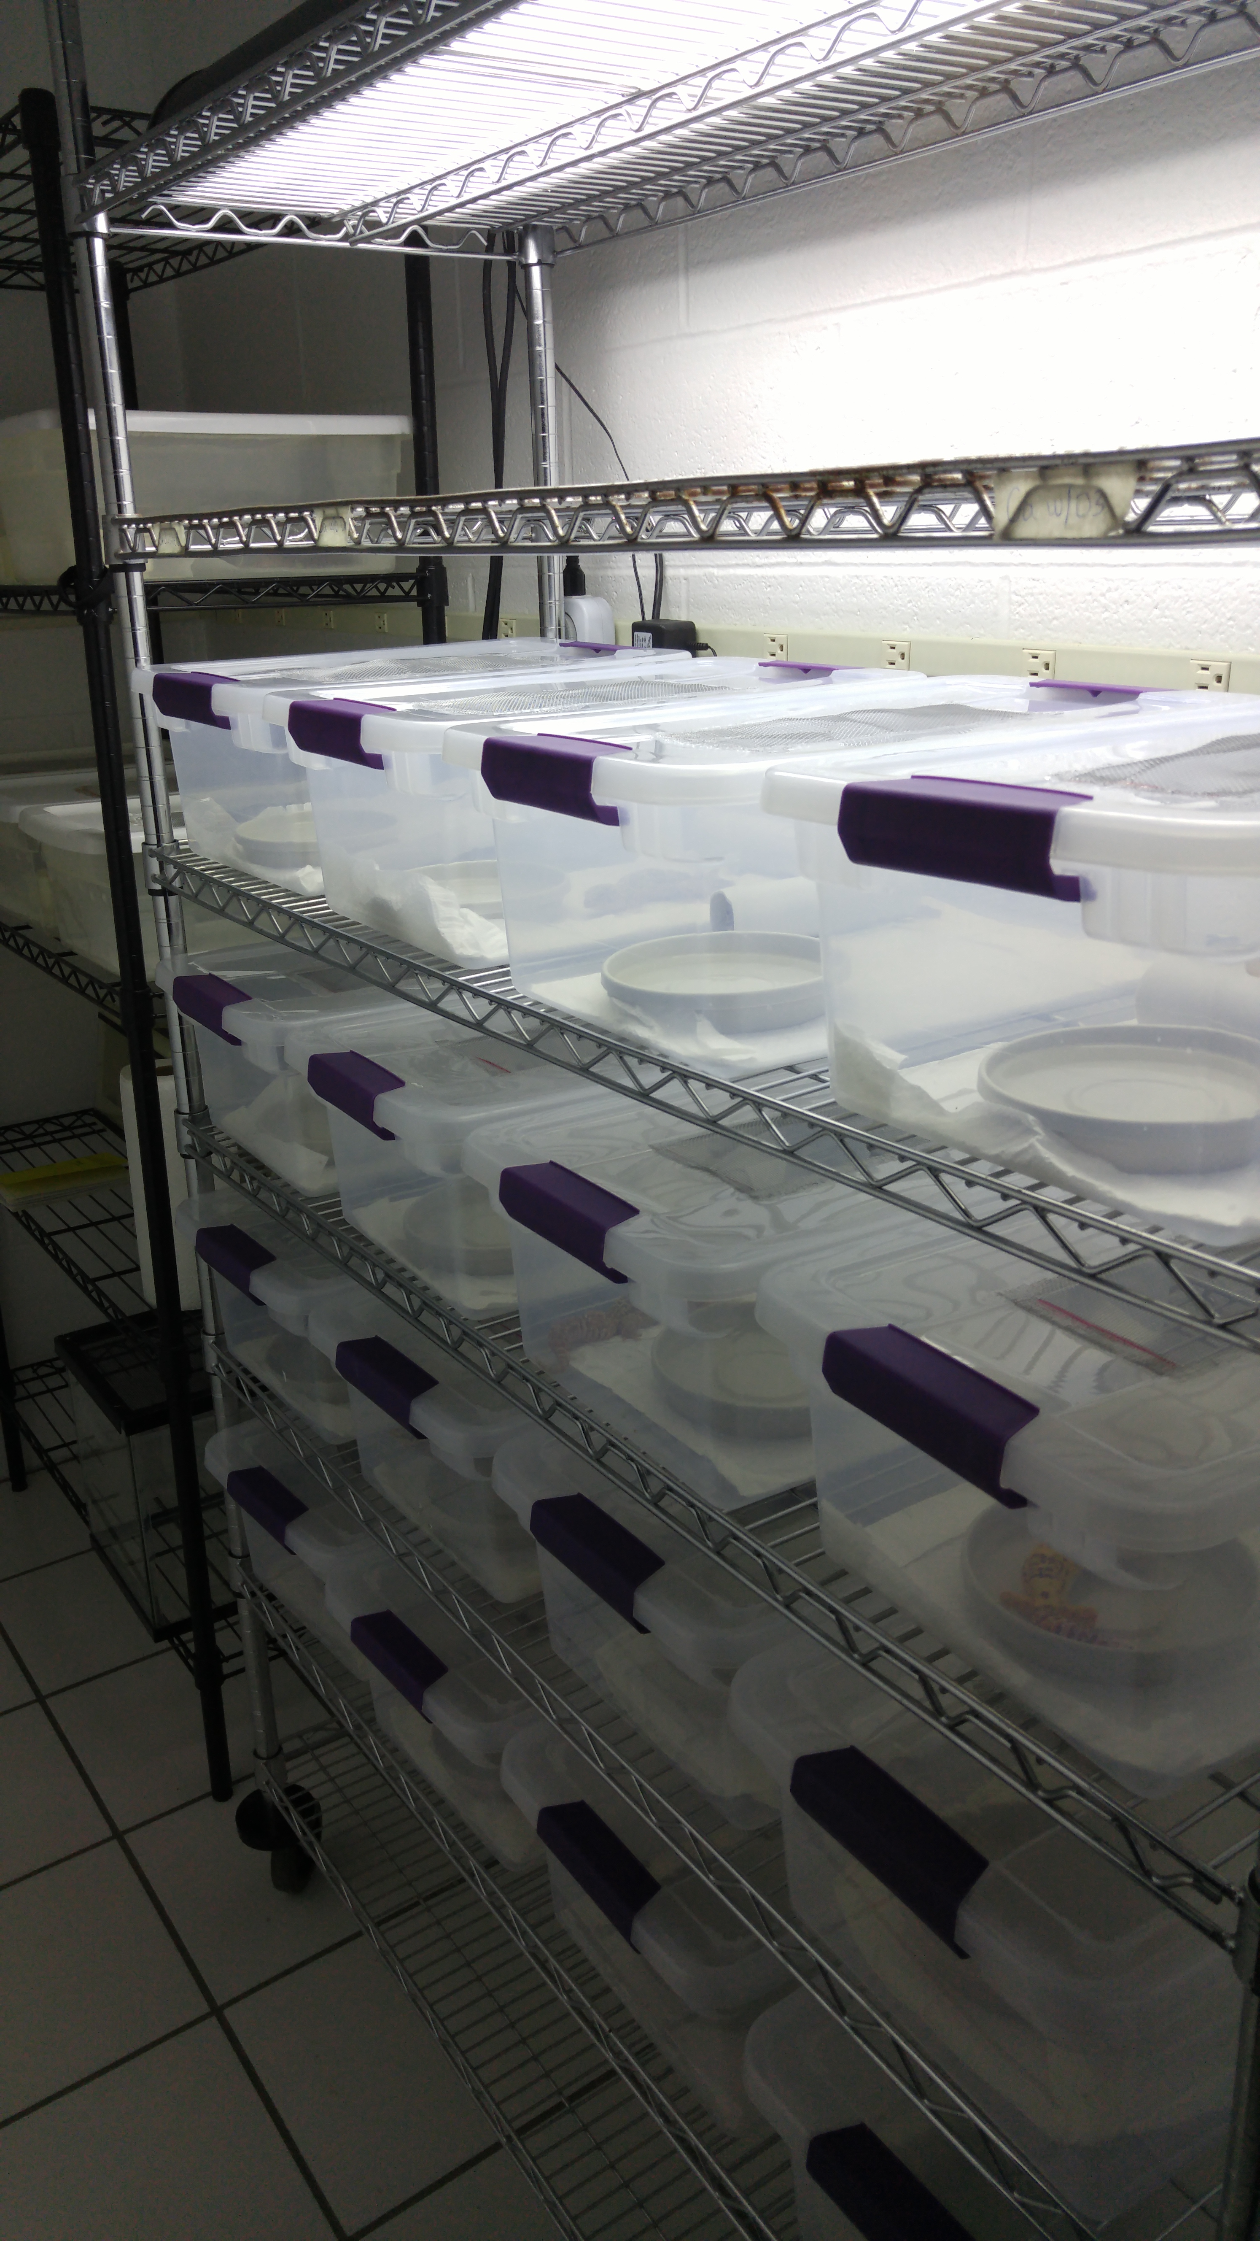
Analysis of Nutritional Supplements consumed by
Female Leopard Geckos on their Growth & Behavior
Lisa Keys Advisor : Dennis Ferraro
Results
Introduction
When intending to breed female reptiles, it is typically a good idea to increase their daily calcium intake to assist in shell development. If the female is unable to obtain the necessary amount of calcium from her environment then she will pull calcium from her bones and become more at risk for metabolic bone diseases. However it is unclear whether the diet of the female has any effect on her behavior towards males.
This research was aimed at determining how the diet of female leopard geckos affected their overall behavior. This included behavior towards unfamiliar males and quantitative measurements.
Discussion
Females fed undusted crickets are going to do very poorly in a captive setting.
Gut loading alone is not enough to satisfy all the nutritional requirements and so supplementation is needed.
While the total body weight of the female would change, the tail size would stay the same overall.
Two potential reasons why copulation wasn’t observed; some of the males used had very low libido, and the time length given for observation was not long enough to allow for initiation and completion of copulation.
Methods
Kept 16 female leopard geckos in separate containers while controlling humidity and temperature.
Once a week I would measure their total body weight, tail cc, and tail width and height.
Fed 14 females twice a week and 2 females once a week as they would have become obese if fed more.
Separated into four groups with four dustings on crickets fed
Non-supplemented, supplemented with vitamins, supplemented with calcium, and supplemented with calcium with D3.
Introduced male once a month into the female cage and time spent interacting and behavior exhibited was recorded and a rank given between -1 and 2.
The max amount of time for interaction was 5 min
-1 being aversive or no interaction and 2 being copulation
R² values suggest females fed Calcium with D3 supplemented crickets will have an increase in total body weight
R² values suggest females fed Calcium dusted crickets under certain conditions will have an increase in total body weight.
R² values suggest females fed unsupplemented crickets would lose total body weight.
There was statistically no change in tail size throughout the experiment.
There were two females fed unsupplemented crickets and one fed vitamin supplemented crickets that lost weight throughout the experiment.
Fecals for unsupplemented females were not well formed while fecals for Calcium with D3 females developed calcium deposits.
Female behavior toward males was erratic and slightly dependent on male initiative
Acknowledgements
Dennis Ferraro
Unl UCARE program
UNL IACUC
UNL Herpetology lab
Nebraska Herpetological Society
UCARE

